Slide 1
How to use Tolcap
Getting Started

Slide 2
When to use Tolcap
Use the Tolcap software whenever you are about to specify a tolerance for a key dimension on a part, or when you want to check why a problem feature is proving difficult to make – does the problem go back to the design?
From the concept stage of a design, you start defining dimensions, and usually the function of the part demands that the dimension be held within a certain tolerance. But can your supplier manufacture to that tolerance consistently?
Tolcap predicts the process capability, C_{pk} , in production of that feature.
The following slides outline how Tolcap works and how to get that prediction from Tolcap.

Slide 3
How does Tolcap work?
The Process Capability of a toleranced dimension depends on
the manufacturing process to be used
the material
the geometry of the part
the state of the tools and machinery
the capability and maybe the past experience of the supplier.
It sounds a complex interaction – and it is! But Tolcap leads you through the main factors to a good working estimate of process capability.

Slide 4
Process Maps
The prime factor determining process capability is the manufacturing process. Parts are formed by such processes as:
Forging: deforming billets with a hammer
Turning: chipping swarf off a rotating bar
Casting: melting metal, pouring it into a sand mould and letting it freeze
The process capability that is ultimately achievable depends on how well an experienced manufacturer can control all the variables to get the best out of the basic physics of the process.

Slide 5
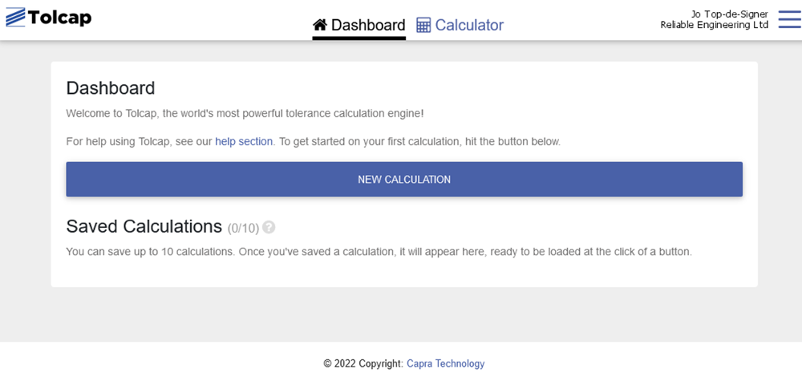
Process Maps
To use Tolcap, log in to an existing account at https://tce.tolcap.com/login,
or sign up for a trial via the links on that page.
The first screen is the Tolcap Dashboard (illustrated in desktop computer layout):

Slide 6
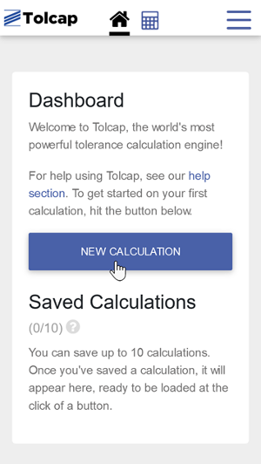
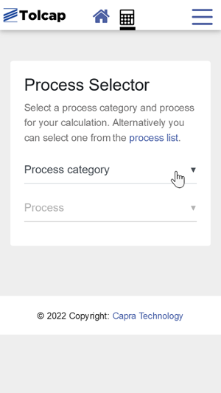
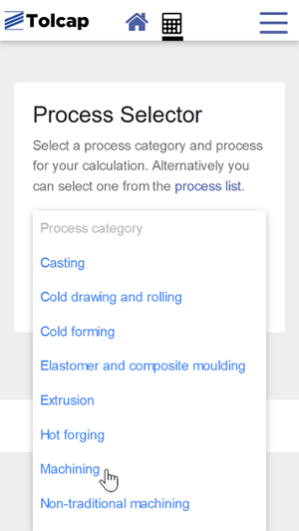
Process Maps
Click ‘NEW CALCULATION’ (now illustrating iPhone 5 layout):
Select the process category for the manufacturing process that defines your designs dimension of interest.
For example Machining:

Slide 7
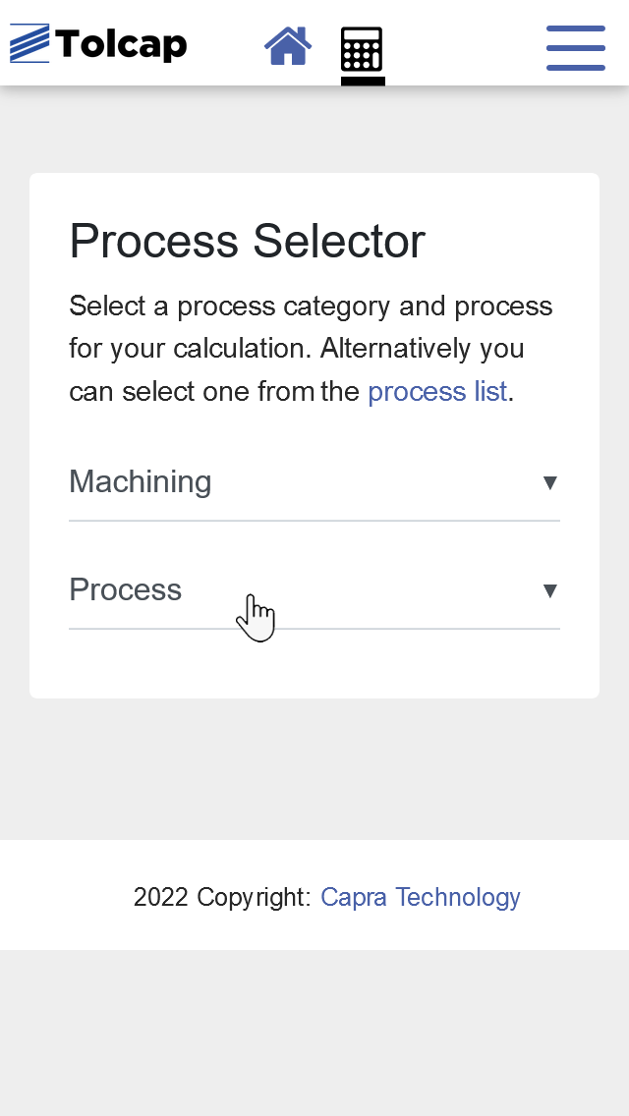
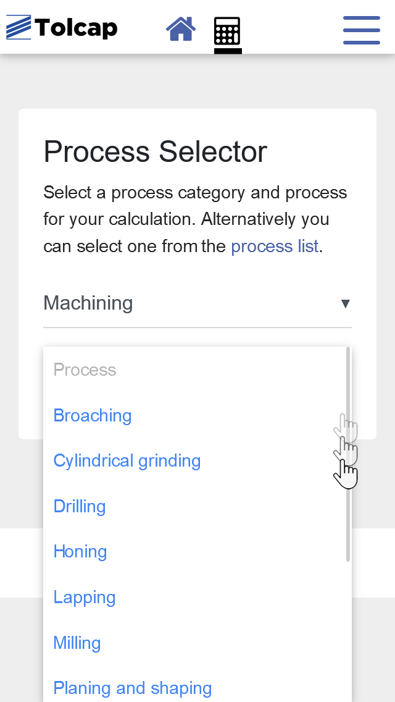
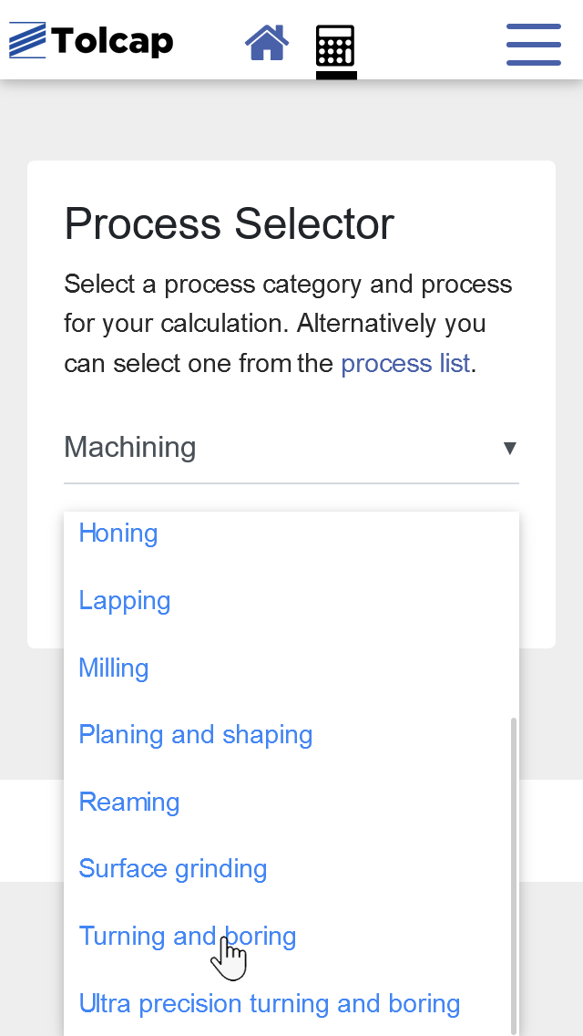
Process Maps
… and select Turning and Boring as the final process to form the dimension of interest

Slide 8
Process Maps
Above we’ve illustrated Tolcap screens in both desktop computer and mobile phone layout. Tolcap will happily adapt to the size of device you are using - convenient for working at you desk, or for quick references on your phone during consultations with colleagues.
From here on we will use screenshots, or partial screenshots, from a tablet sized device.

Slide 9
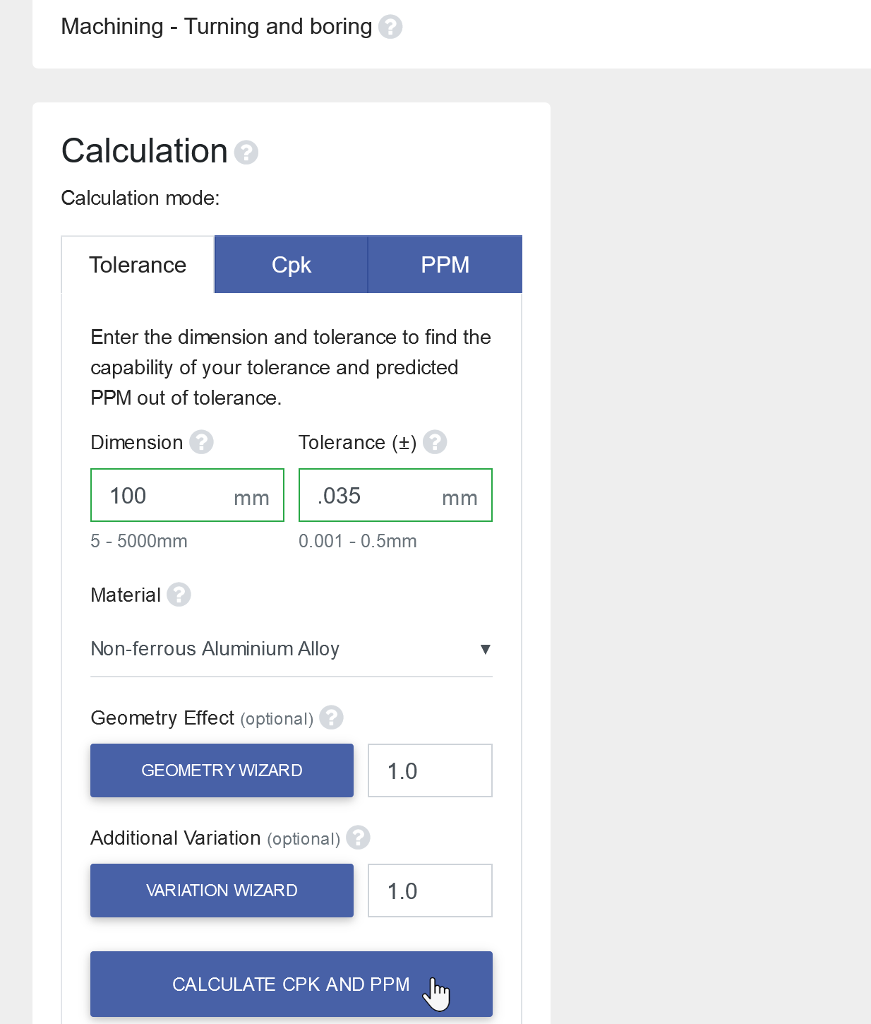
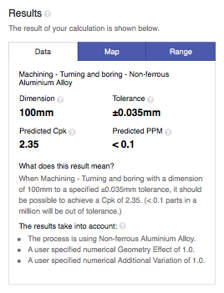
Process Maps
Enter the dimension of interest ‘100’ , the required tolerance ‘0.035’ and ‘Calculate’:
In the Results ‘Data’ tab you will see the predicted process capability of 2.35:
Next select the ‘Map’ tab …

Slide 10
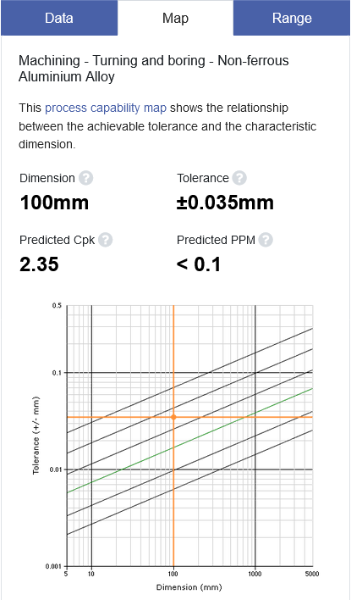
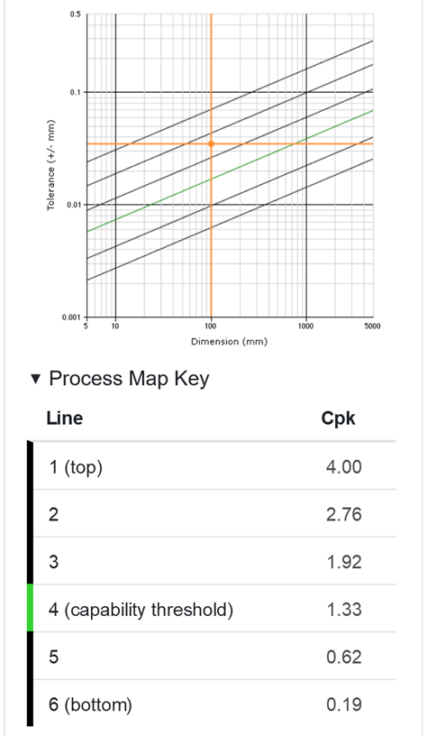
Process Maps
…..to see the result on a process map.
The process maps are the heart of Tolcap.
The Tolcap web application incorporates capability maps for over 80 manufacturing processes.
The maps plot dimension against tolerance for each process (log - log).
The diagonal lines on the maps are lines or contours of constant process capability. The higher up the map, the higher the process capability - and the fewer rejected parts.

Slide 11
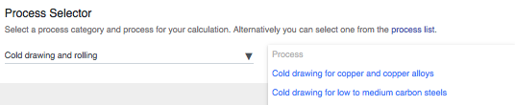
Material Effect
So far the process capability estimate should be achievable by a competent component supplier in an ideal case, using best practice. We could expect C_{pk} = 2.35.
Just thinking again about the physics of the process – the properties of the material being processed will have an effect: hardness, malleability, thermal expansion coefficient, etc.
Where there is a strong interaction between the process and the part material, Tolcap provides alternative process maps for groups of common materials
For other processes the prediction from the standard map is modified by a ‘material to process factor’ …

Slide 12
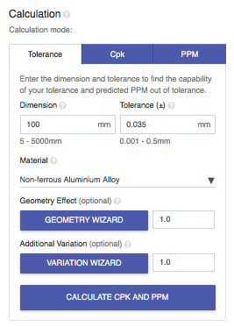
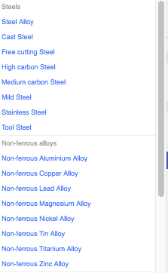
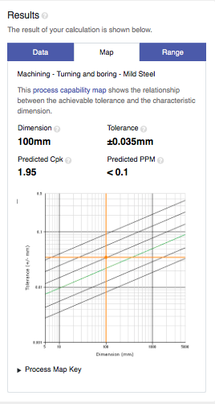
Material Effect
In the Calculation pane, click the arrow by the default material (here ‘Non-ferrous Aluminium Alloy’ - but this is process dependent) and select a material from the drop down list.
You don’t need the precise specification of the material – should your material not be shown select one with similar relevant properties. Here we select mild steel:
... and notice the decrease in predicted C_{pk} to 1.95 – still good.

Slide 13
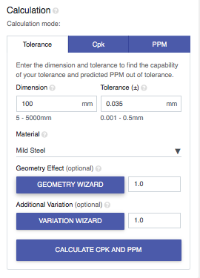
Geometry Effect
Next we consider factors related to the geometry of the part.
Click the Geometry Wizard:

Slide 14
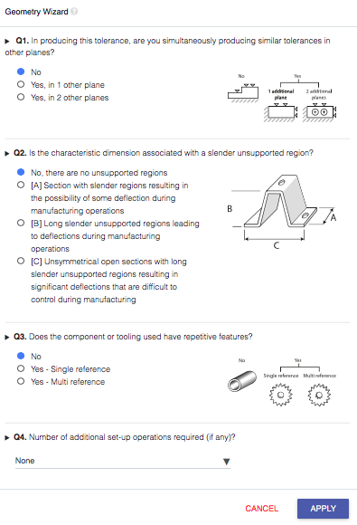
Geometry Effect
The questions vary with the process. There are help images to illustrate the issue.
Here we are asked:
How many planes we are machining at one time – maybe facing while turning.
Is the part long and slender – it is more difficult to hold tolerances than for a squat sturdy part.
Repetitive features will show more variation.
Are there addition set up operation -perhaps the part has to be removed, turned round and re-set up on the lathe.
Here let’s suppose we are boring a hole in a part with long slender unsupported regions and we have to turn the part around to bore the hole:
Click button ‘B’ and set the number of additional set-up operations to ‘1’ then click ‘APPLY’…

Slide 15
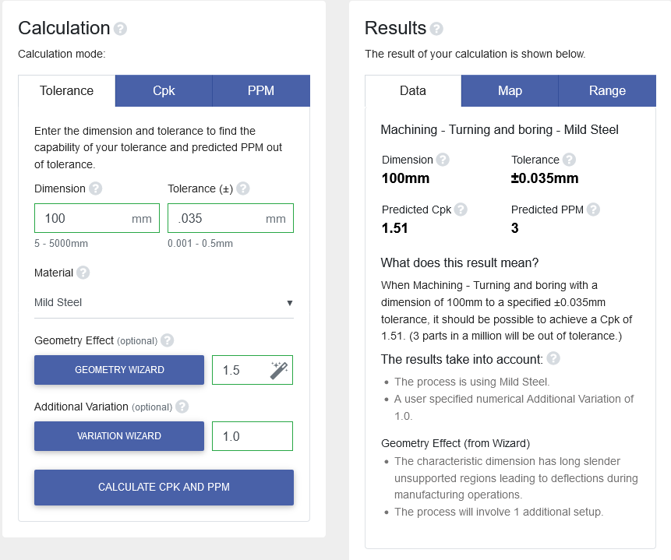
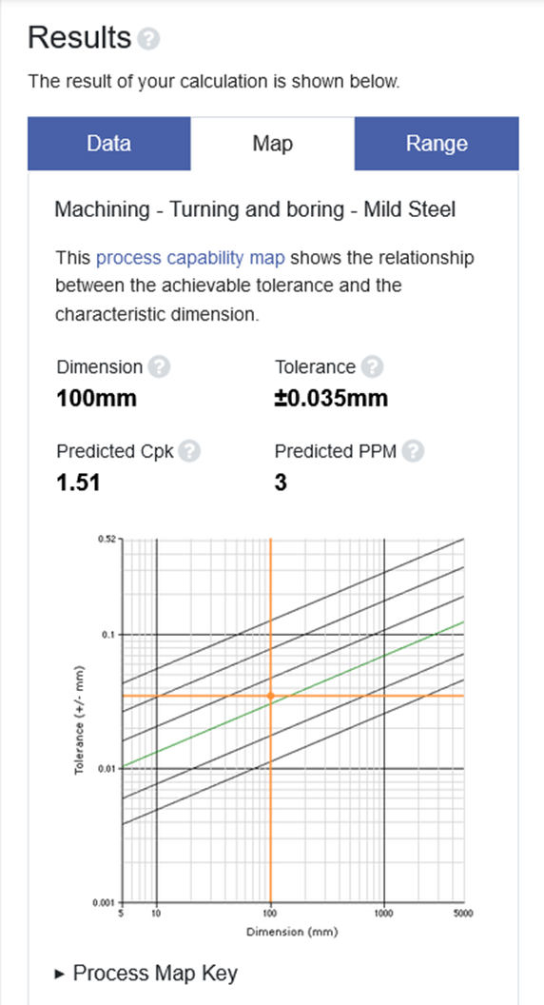
Geometry Effect
On the Data tab the Results ‘Predicted C_{pk}’ further decreases to 1.51.
Note also the ‘Geometry Effect’ value and wand, and updated ‘Results take into account’:
Also on the Map tab:

Slide 16
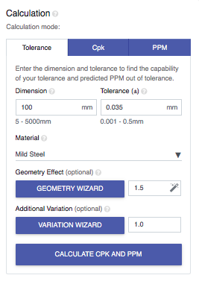

Additional Variation
Next we consider some additional factors.
Click the Variation wizard:

Slide 17
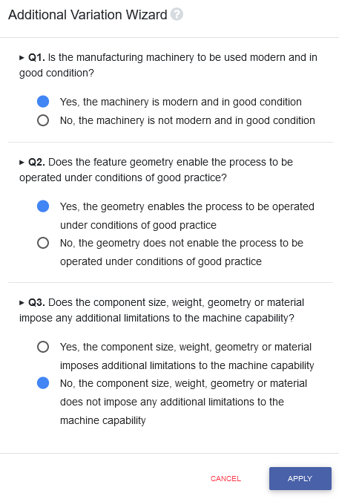
Additional Variation
The state of the manufacturing machinery may affect process capability.
The feature geometry may be at the limits of feasibility, or the part may be at the limits of size or weight – too big or too small.
Let’s suppose our part is large – near the capacity limit of the lathe, and answer ‘yes’ to the component size question.
Click the ‘Yes’ button and then click ‘APPLY’…

Slide 18
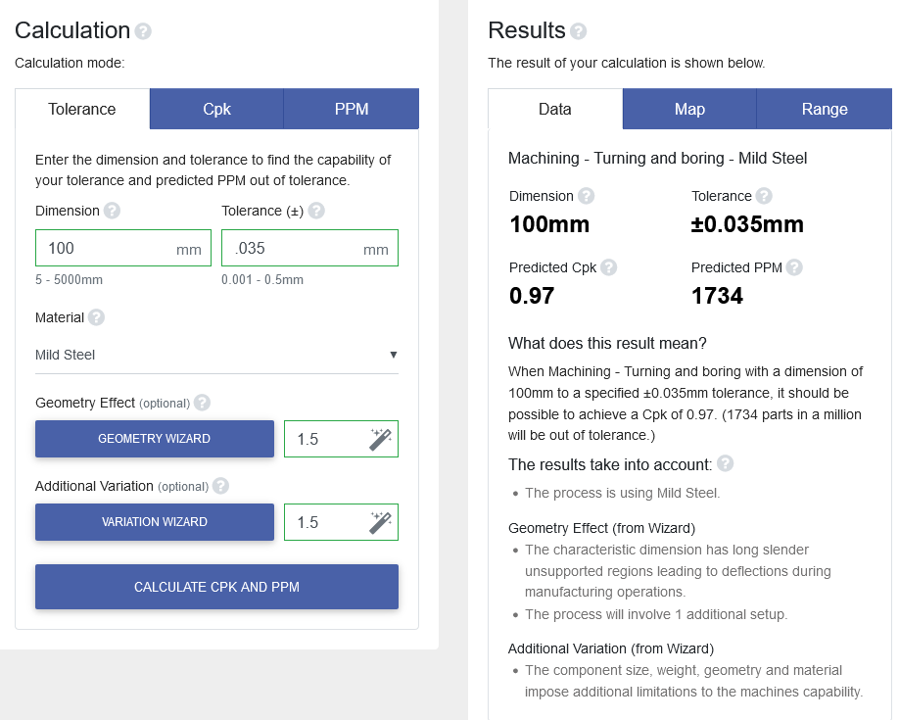
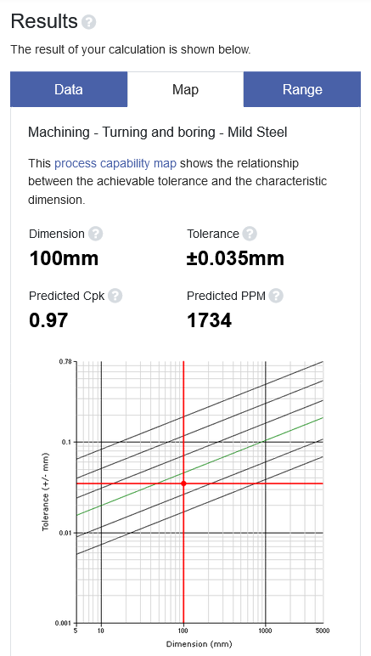
Additional Variation
... and notice that C_{pk} has fallen to an unacceptable 0.97.
We may need to reconsider the design – but better to take the result to the supplier and discuss the problems first.
On the Map tab a warning red cross hair:

Slide 19
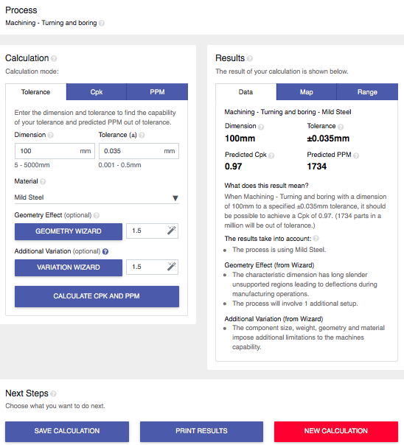
Save
You can save completed calculations.
Tolcap will ask you for a ‘Reference’ and ‘Description’ so you can retrieve it.

Slide 20
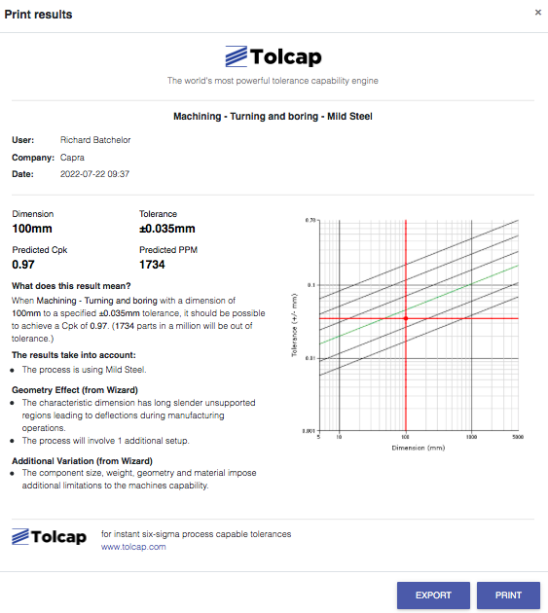
Print or Export
To print your results click the ‘PRINT RESULTS’ button taking you to the print layout format shown. Click ‘PRINT’.
The printout will show any Save references, together with information from Data and Map tabs.
Exported data will be exported as .csv row.

Slide 21
Summary and Next Steps
This presentation is meant to help get you started.
If puzzled, try using Tolcap, go through this material again, or see the next presentation that gives some more explanations and an alternative approach you may find simpler.

Slide 22
For more information visit
www.tolcap.com

