Slide 1
How to use Tolcap
Achieving Capability

Slide 2
Using Tolcap – From Capability to Tolerance
The previous presentation showed how Tolcap provides you with a prediction of process capability for the dimension you specify and the tolerance determined by the function of that feature of the design.
If the Tolcap algorithm can get from dimension and tolerance to process capability, then we can re-arrange the algorithm to calculate the tolerance required on a dimension for a specified process capability - and to project from the process capability curves on the charts back to read off that tolerance.
Why would you want to do that?

Slide 3
Using Tolcap – From Capability to Tolerance
Working from required capability to tolerance has three useful applications:
Finishing Process Required? Will it be sufficient to drill the holes in a part, or is it necessary to ream them?
Tolerance stacks / stackups - The next presentation treats tolerance stacks and shows that the stack tolerance capability is maximised when the component dimensions of the stack are equally process capable. Tolcap shows you the tolerance to achieve that capability.
Tolerance Confidence Limits - Tolcap will show an optimistic and a pessimistic tolerance to achieve a required process capability - particularly helpful if you are not confident in the geometry or process factors you have chosen.

Slide 4
Using Tolcap – From Capability to Tolerance
To show how to use Tolcap in this mode, we will work through the same example as in the previous presentation - a dimension of 100mm on a part that is turned and bored. In Part 1 we specified a tolerance of ± 0.035mm, but this time we will specify a process capability, C_{pk}.

Slide 5
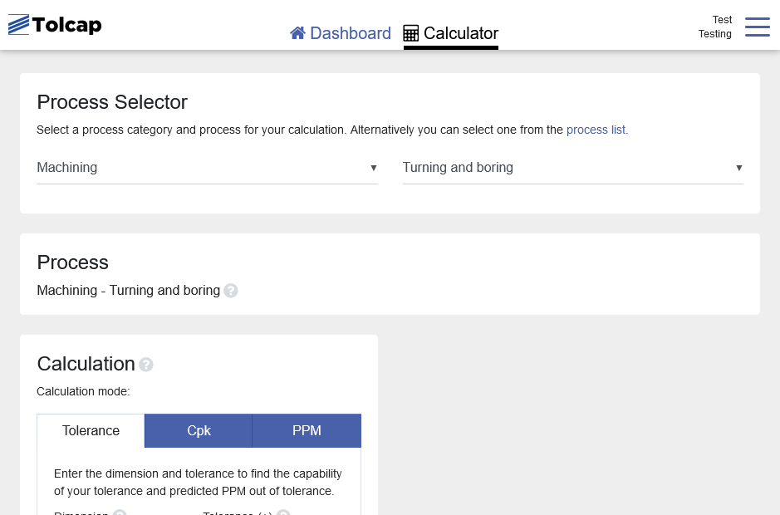
Using Tolcap – From Capability to Tolerance
So as before, log in (at https://tce.tolcap.com/login ) and select the process category for the manufacturing process that defines the dimension of interest in your design. Here ‘Machining’ and ‘Turning and Boring’…

Slide 6
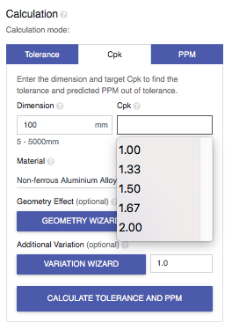
Using Tolcap – From Capability to Tolerance
This time
first click the ‘Cpk’ tab
then enter 100 as the ‘Dimension’
and click on the ‘Cpk’ box
to see a drop down choice for target C_{pk}

Slide 7
Design for the C_{pk} you choose
You may enter any value between 0.05 an 4 as target C_{pk} , the drop downs provide prompts for popular values.
The Tolcap approach reflects good practice at the time the algorithm was constructed (Ford PPAP) i.e.
demonstrate C_{pk} = 1.67 off the first off-tool run
and ensure C_{pk} > 1.33 throughout production.
The Tolcap prediction addresses that last clause, so our recommended default C_{pk} target is 1.33.
So click 1.33 then ‘Calculate Tolerance and PPM’…

Slide 8
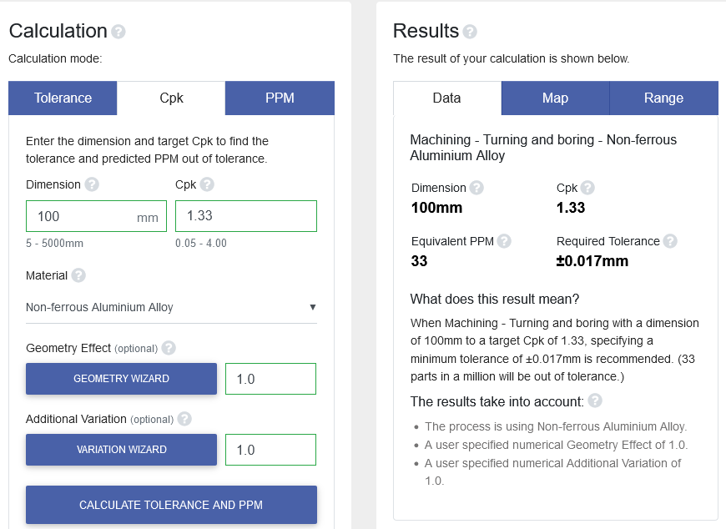
Design for the C_{pk} you choose
… and you will see the required tolerance to achieve C_{pk} = 1.33, or the equivalent 33 PPM reject rate, shows ±0.017mm:
- but …

Slide 9
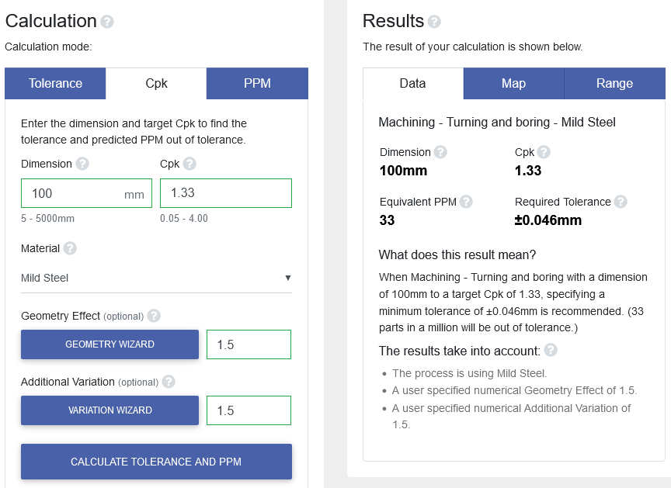
Design for the C_{pk} you choose
As we did in our Part 1 example
select Mild Steel,
apply ‘Geometry Wizard’
and apply ‘Variation Wizard’
You will see to achieve a C_{pk} of 1.33 the ‘Required Tolerance’ is ±0.046mm.

Slide 10
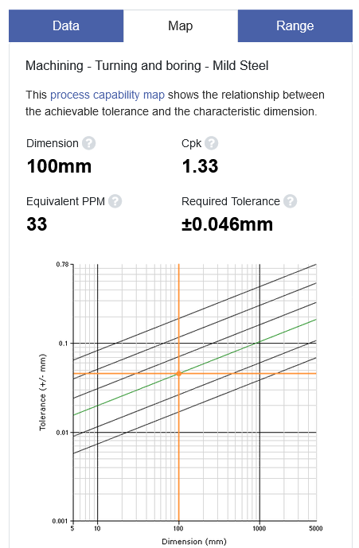
Design for the C_{pk} you choose
… and the result on the map:
So recapping our material, geometric and variation adjusted results from Parts 1 and Parts 2 …

Slide 11
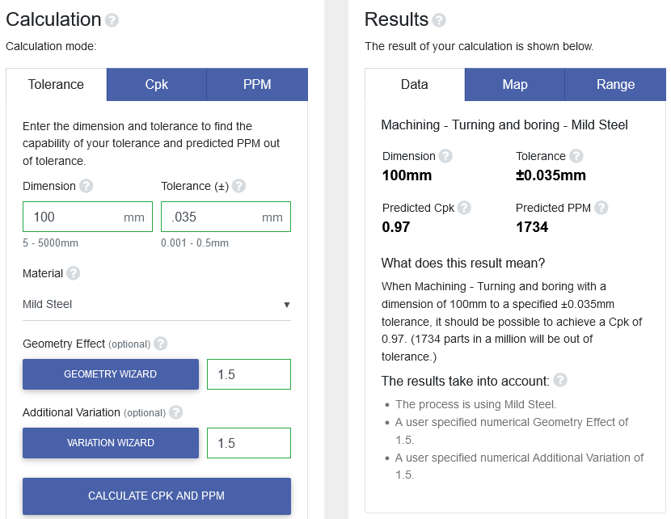
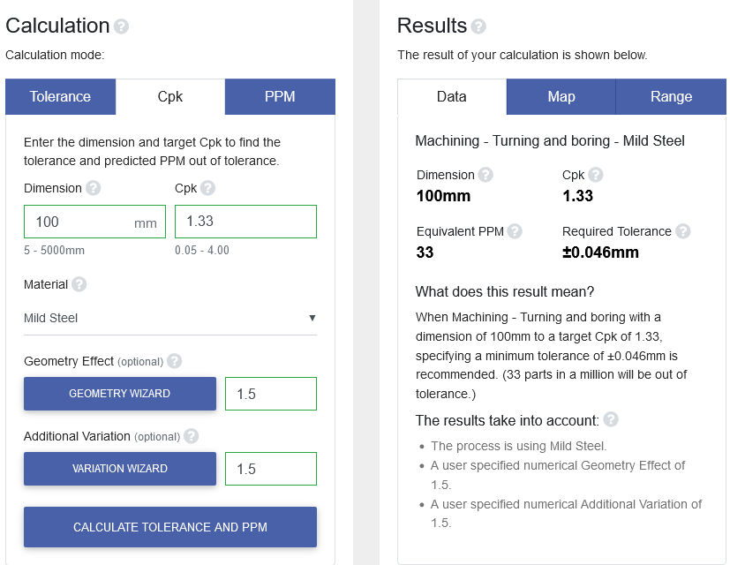
Design for the C_{pk} you choose
Part 1
When we selected a required tolerance of ±0.035, Tolcap predicted a C_{pk} of 0.97
Part 2
To achieve C_{pk} = 1.33, Tolcap predicts that a minimum tolerance of ±0.046mm should be specified

Slide 12
A Tolerance Range?
While our introduction describes the recommended way to use Tolcap, some users find it daunting.
OK, you know the dimension and tolerance, you can choose a process and material, but the geometry and additional variation questions are too hard!
Let’s work the example once more, this time just specifying the process, the dimension, the target C_{pk} and the material …

Slide 13
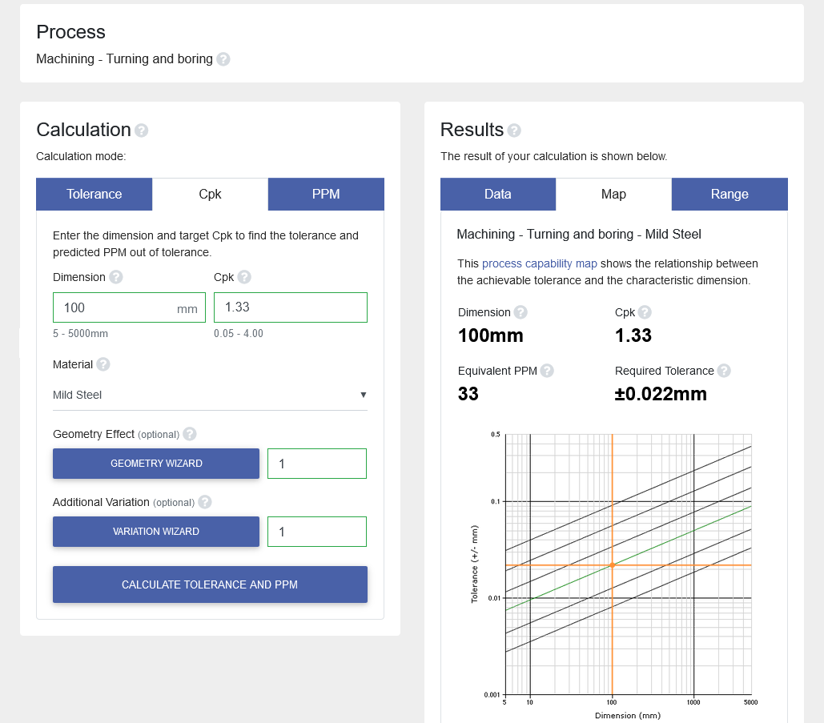
A Tolerance Range?
Select
Turning and boring
The ‘Cpk’ tab
Dimension 100mm
Cpk 1.33
and material Mild Steel
Tolcap suggests that under favourable conditions, minimal geometry effects and no additional variation, ±0.022mm might be achievable:

Slide 14

A Tolerance Range?
What if we aren’t sure what our conditions are at the moment?
Tolcap can show a range of tolerance’s
from that required for the most favourable conditions
to, well - not worst case, but the least favourable that can be imagined in practice.
Click on the Range Tab …

Slide 15
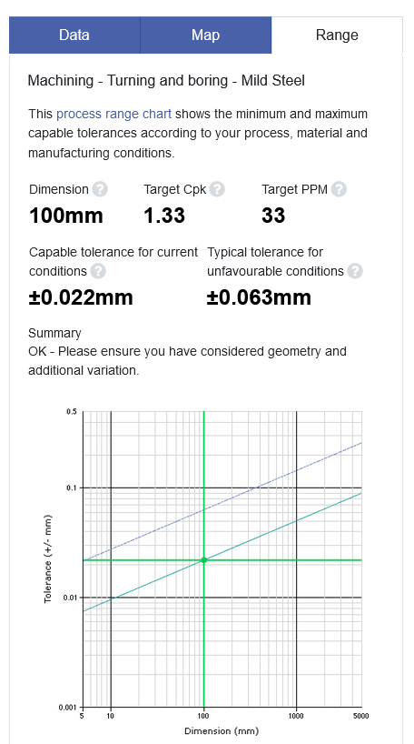
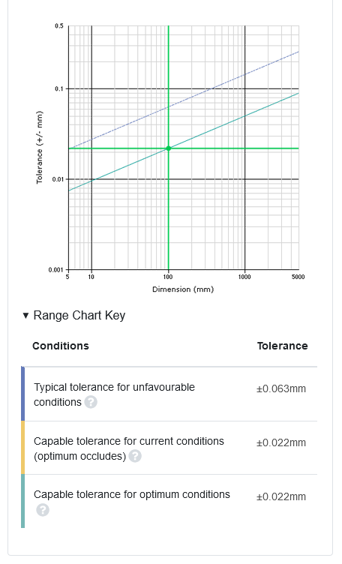
A Tolerance Range?
…and Tolcap shows that while ±0.022mm tolerance may be process capable under the best conditions, at the other end of the scale the tolerance may need to be ±0.063mm.
This puts our original, Part 1, required tolerance of ±0.035 into perspective.

Slide 16
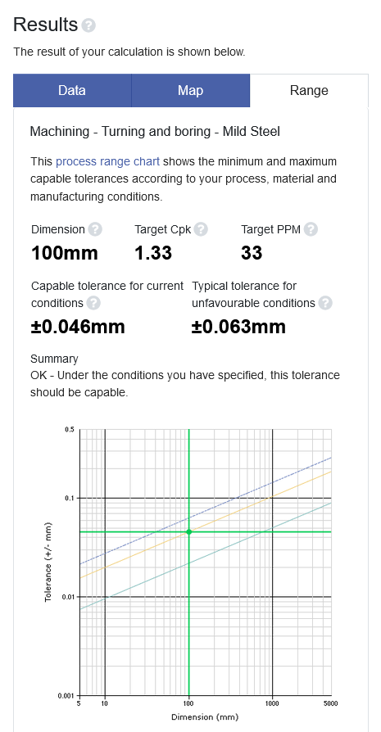
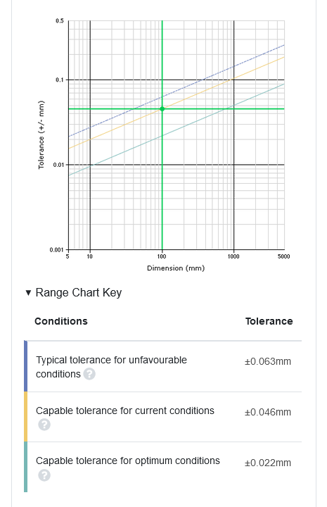
A Tolerance Range?
Of course, the more you put in, the more you get out of Tolcap.
If we apply the ‘Geometry’ and ‘Variation Wizards’ as before, the Range chart will show the minimum tolerance predicted to achieve process capability
for the entered conditions
for most favourable conditions
and for the least favourable conditions.

Slide 17
Using Tolcap
We hope these introductory presentations have shown you why Tolcap is a unique and vital tool for designers.
Setting achievable tolerances saves your organization significant costs and saves you a lot of that stress and distraction sorting out designs that could otherwise turn out not capable.
Tolcap helps you check the capability of a tolerance or generate a tolerance with a target capability.
Our next presentation explores the problems of tolerance stacks and how Tolcap provides solutions.

Slide 18
For more information visit
www.tolcap.com

