Slide 1
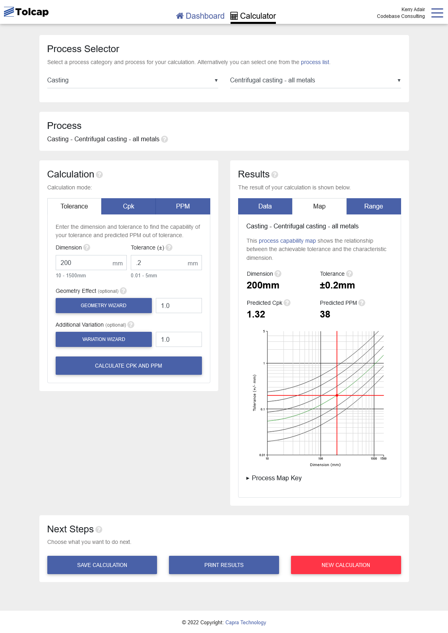
Tolcap Training - App version 2

Slide 2
Tolcap Training
Objectives
To demonstrate the importance of tolerance allocation and process capability in design and manufacture.
To introduce the Tolcap methodology and software, and its role in engineering capable products.

Slide 3
Tolcap Training
The Importance of Tolerance Capability
It is not uncommon for businesses to face quality losses of 20% of total revenues.
- Stan Field, Quality Director BAE SYSTEMS
30% to 50% of scrap and rework is caused by poor tolerancing.
- Steve Scigliano, Quality Guru Tecnomatix Technologies
Process Capability is extremely important to Rolls-Royce as incapable processes erode profits and compromise our competitiveness.
- Hamid Mughal, Manufacturing Engineering Director, RR UK
As a modern – cost-conscious company - we must move towards understanding process capability and designing within it.
- Stuart Lee, Design Capability Owner, Rolls-Royce, RRD

Slide 4
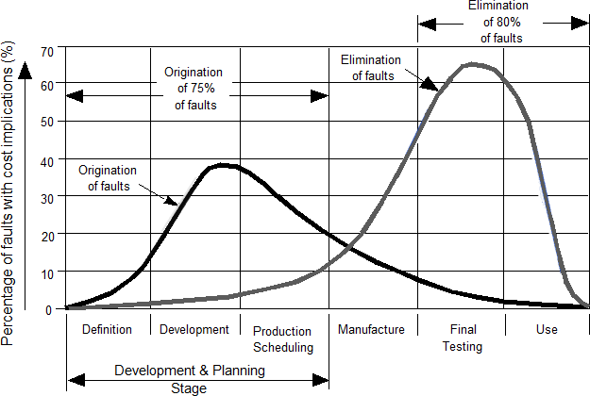
Tolcap Training
Occurrence & Elimination of Faults in Product Development

Slide 5
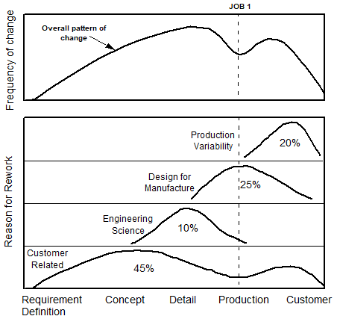
Tolcap Training
Disposition of Rework in
Product Development:

Slide 6
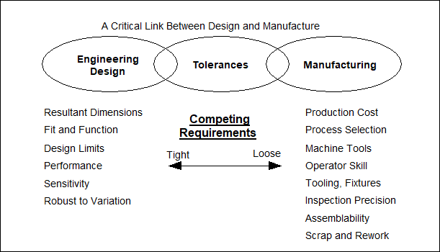
Tolerances
Link between Design and Manufacture

Slide 7
Tolerances
Tolerances guarantee the proper functioning of the product to satisfy customer requirements and technical constraints.
Designers understand functional tolerances, but often information is not available on manufacturing process capabilities.
In consequence we need tools and techniques to support the design process, manufacturing and supplier development.

Slide 8
Process Capability
There are two types of variability:
Common-cause - is inherent in a machine/process by virtue of its design, construction and the nature of its operation - positional repeatability, machine rigidity, which cannot be removed. When only common cause variability is present, the process is performing at its best possible level under the current process design.
Special-cause - is due to sources that can be systematically identified and eliminated, for example, tool and functional accuracy, operator error, set-up errors, deformation.
If the material or geometry being processed is not well suited to the process then this can limit the capability that can be achieved.

Slide 9
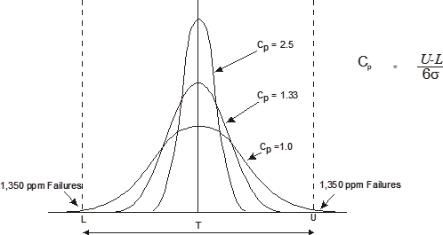
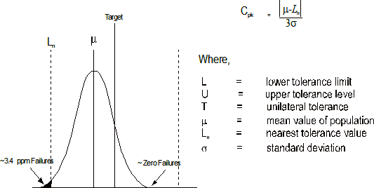
Process Capability Indices
Link tolerance and process variation
Process Capability for a
Central Distribution
Process Capability for a
Shifted Distribution (Cpk = 1.5)

Slide 10
Process Capability Indices
Cpk | ppm
2 | < 0.1
1.5 | 3.4
1.33 | 33
1 | 1350
0.8 | 8200
0.5 | 67000
0.3 | 184000

Slide 11
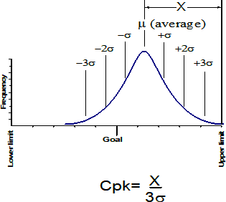
Process Capability
The Importance of Cpk
Engineering impacts the numerator of this equation (X) since they control the limits of the tolerance.
Manufacturing impacts the denominator (σ) since they are responsible for controlling variation.

Slide 12
Process Capability
Component manufacture
Factors that effect the process capability of a design include:
Inherent capability of the process
Critical dimensions
Material to process compatibility
Component geometry to process feasibility
Variation due to manufacturing limitations
Note that design decisions have a strong influence on most of these areas.

Slide 13
Process Capability Maps
Cpk = 4
Cpk = 1.33

Slide 14
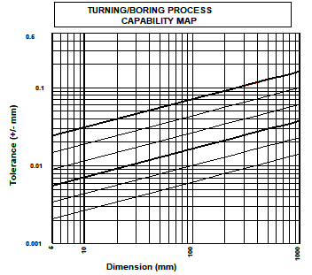
Process Capability Maps
Philosophy
Maps represent good practice.
Appropriate
Dies and moulds
Jigs, fixtures and set-up
Speeds and feeds
Cutting tools etc
Contours of Capability - dimensional tolerances.
Shift and drift are embedded.

Slide 15
Process Capability Maps
Data reflects processes that are under control and operating without special measures.
Prediction uncertainty ~15%

Slide 16
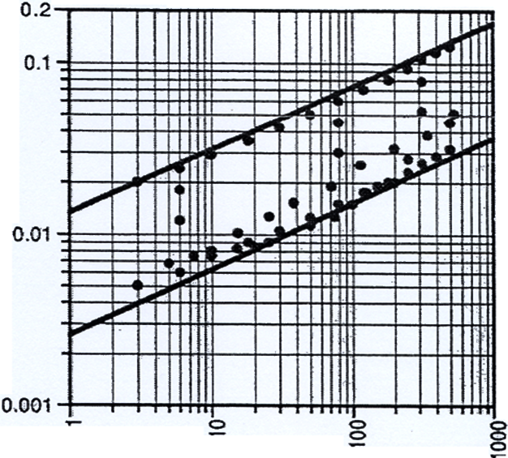
Process Capability Maps
Typically each map is generated using multiple data sources e.g. International Standards, specialised manufacturing businesses and experimental data as illustrated on the map shown.
The range of the maps are dictated by the available data, therefore care must be taken when extrapolating beyond the boundaries.
If you want to work outside the range of a map or use a material not covered contact Tolcap about generation of a bespoke map.

Slide 17
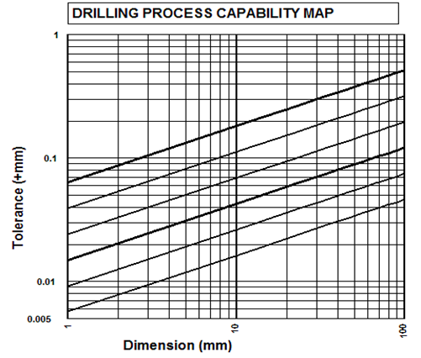
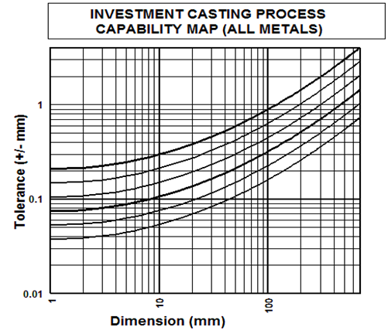
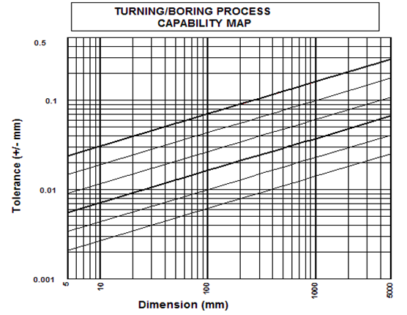
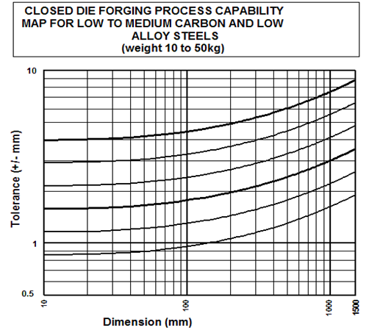
Process Capability Maps

Slide 18
Tolcap Software

Slide 19
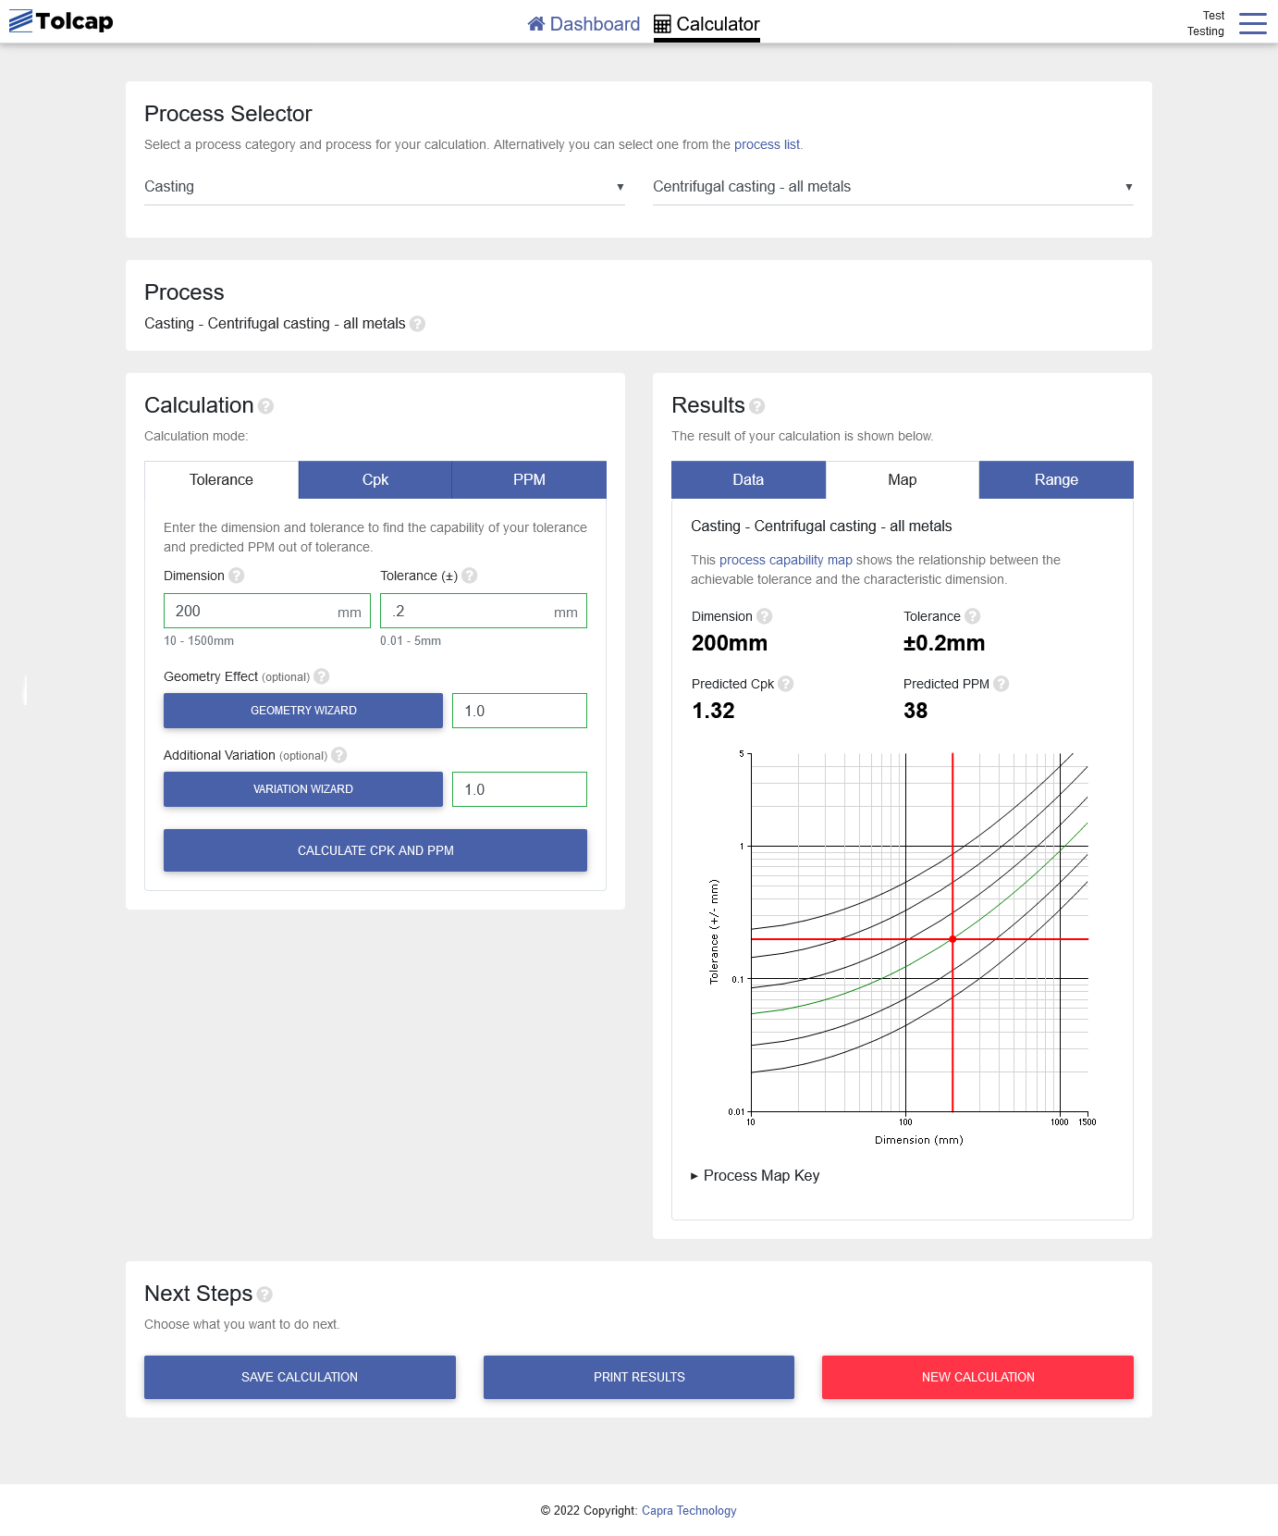
Tolcap Software

Slide 20
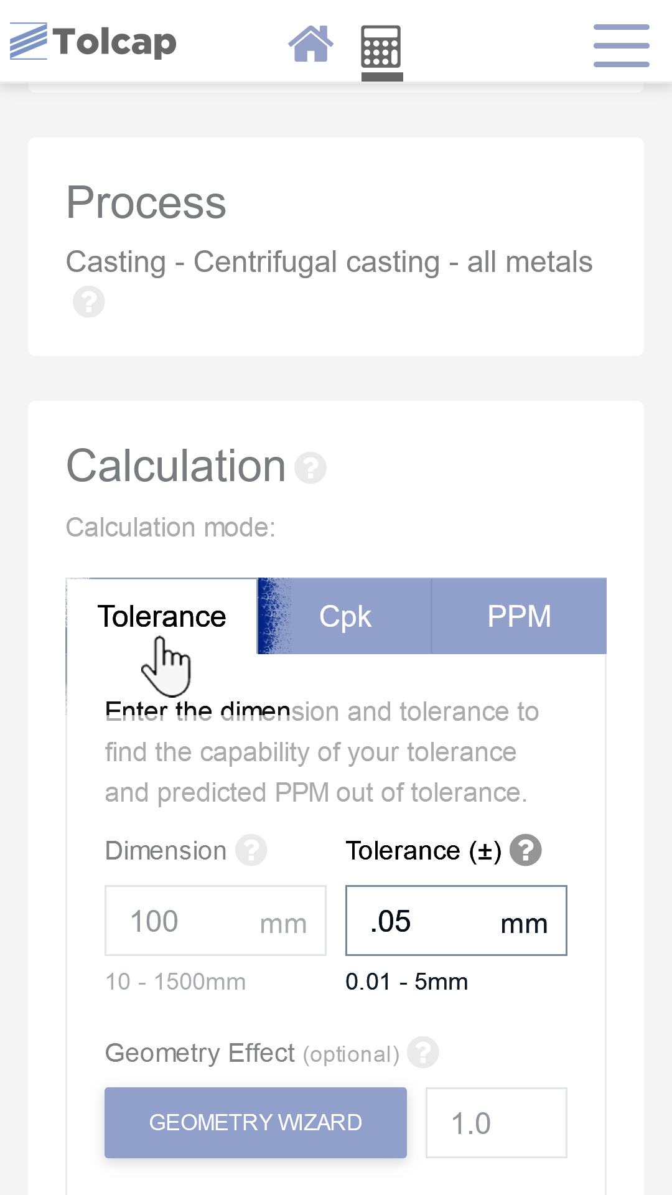
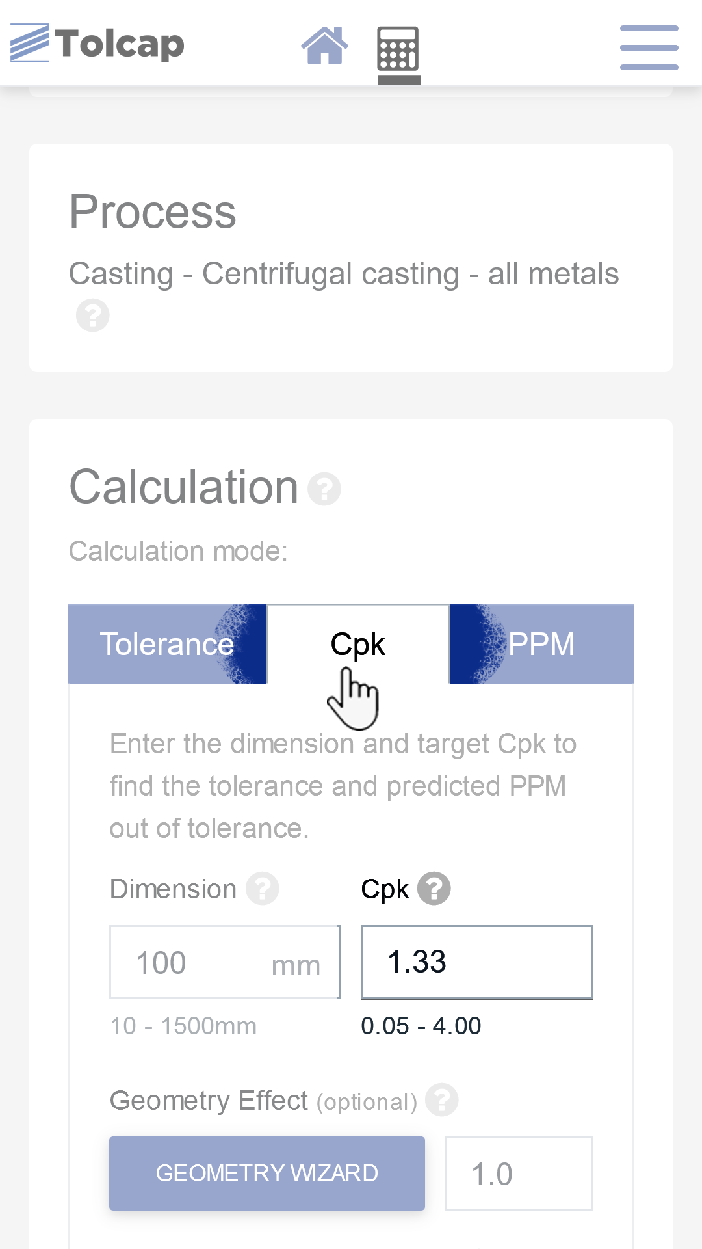
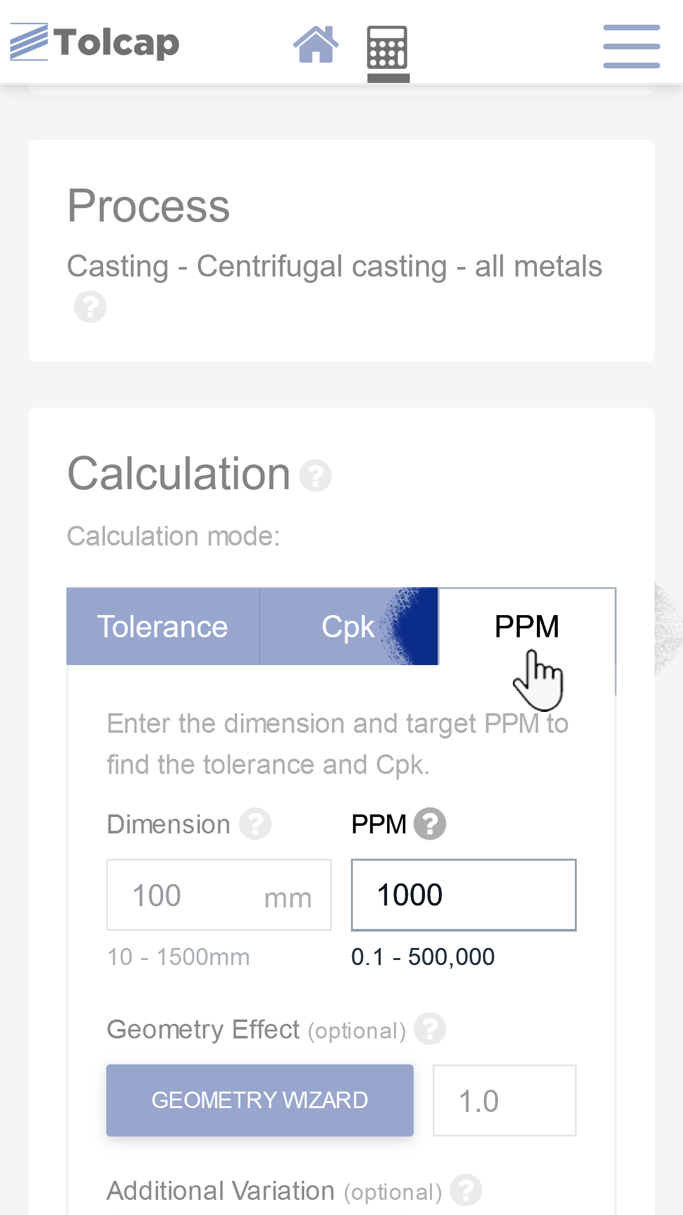
Tolcap Software
Operational modes (illustrated in mobile phone layout)
Cpk / ppm prediction
Tolerance prediction

Slide 21
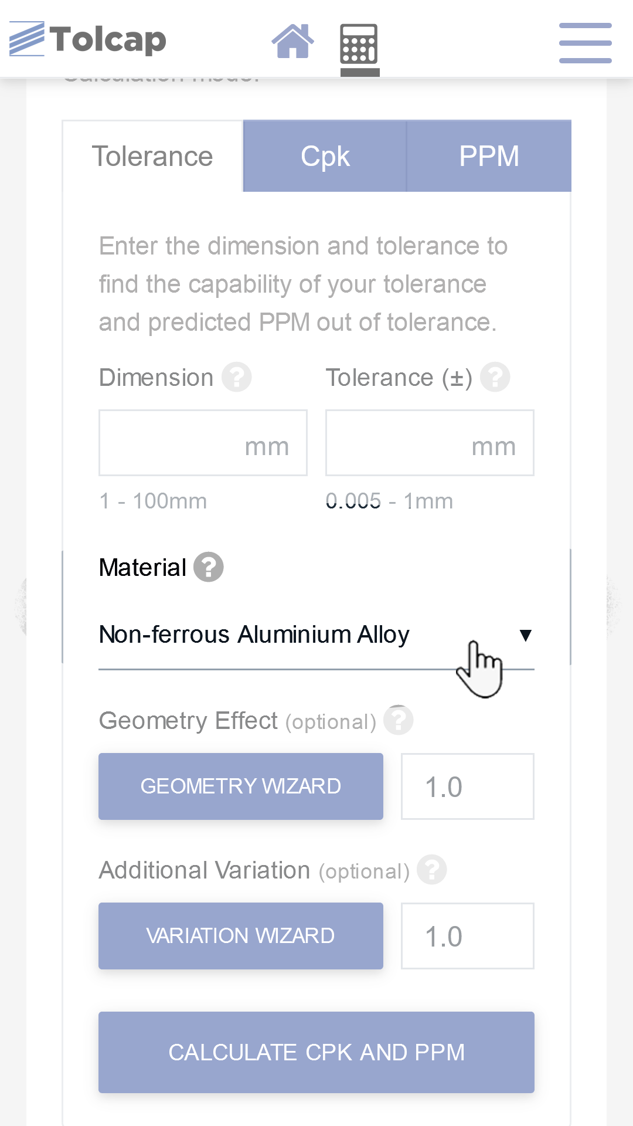
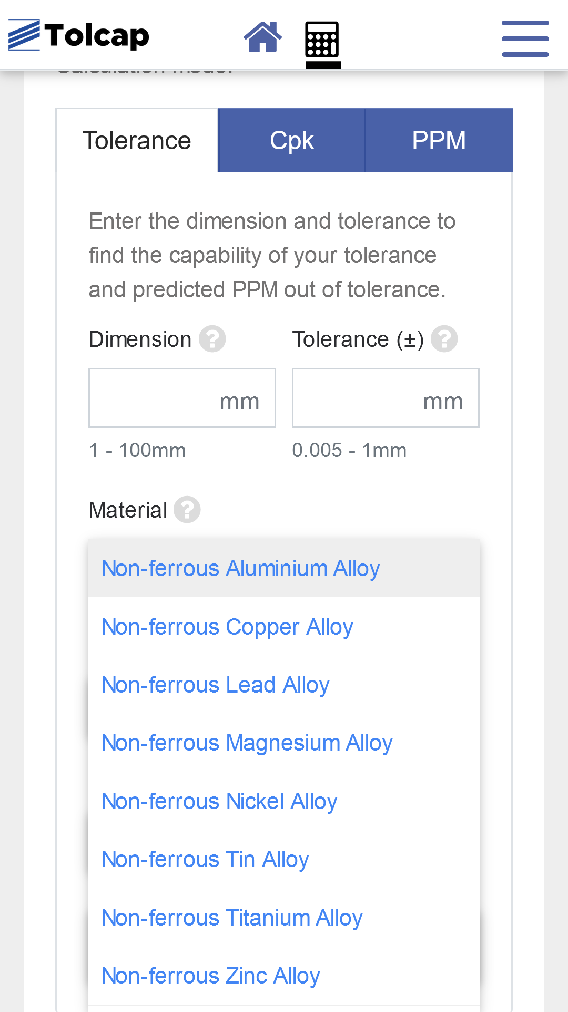
Tolcap Software
Material Dropdown

Slide 22
Tolcap Software
Material-Map relationships
Some maps are applicable to all materials
Often maps are materials specific
Other maps require the material wizard (referenced to ideal material)
The data used to reflect the effect of processing non-ideal materials is based sources such as:
Machinability Data
Expert knowledge
Specialist companies/suppliers

Slide 23
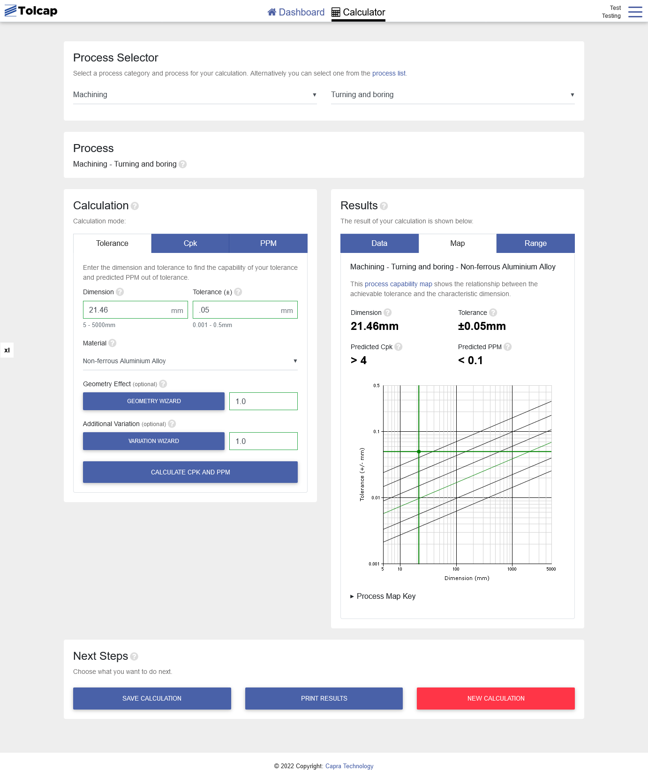
Tolcap Software

Slide 24
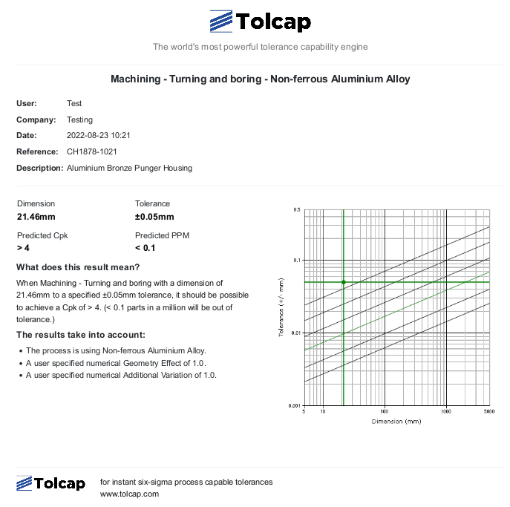
Tolcap Software
‘Print’ includes ‘Data’ & ‘Map’ tab results, and ‘Saved’ Reference and Description.

Slide 25
Tolcap Software
Software Demo
Interface - processes, sizing
Input types
Maps, extrapolation – warning message
Summary, User options – print, export
Tolerance input is +/-

Slide 26
Tolcap Software
Examples

Slide 27
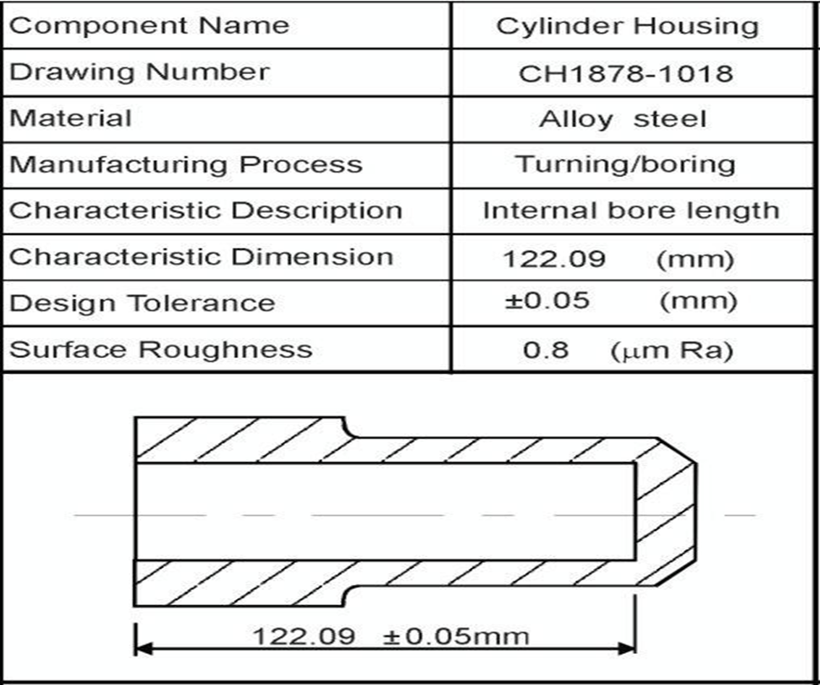
Tolcap Software - Examples

Slide 28
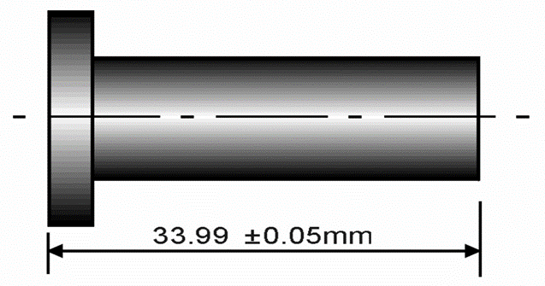
Tolcap Software - Examples
Component Name | Plunger Housing
Drawing Number | CH1878-1021
Material | Aluminium Bronze
Manufacturing Process | Turning
Characteristic Description | Overall length
Characteristic Dimension | 33.99 mm
Design Tolerance | ±0.05 mm
Surface Roughness | 1.6 μm Ra

Slide 29
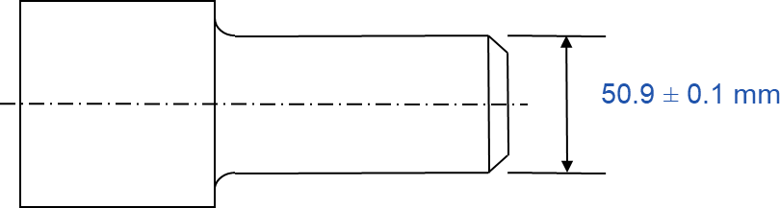
Tolcap Software - Examples
Component name | Cylinder housing
Drawing number | CH1878-1018
Material | Alloy steel
Manufacturing process | Turning
Characteristic description | Outside diameter
Characteristic dimension | Diameter of 50.9mm
Design tolerance | ± 0.1mm

Slide 30
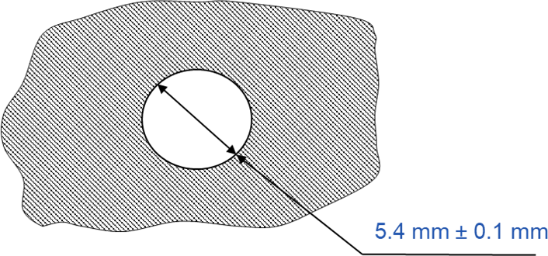
Tolcap Software - Examples
Component name | Bracket
Material | Mild steel
Manufacturing process | Sheet metal punching
Characteristic description | Diameter
Characteristic dimension | Diameter of 5.4mm
Design tolerance | ± 0.1mm

Slide 31
Tolcap Software - Examples
Component name | Capacitor clip
Material | 0.4 mm Alloy Steel
Manufacturing process | Sheet metal cutting
Characteristic description | Width
Characteristic dimension | 18 mm
Design tolerance | ± 0.2 mm
18 ± 0.2 mm

Slide 32
Tolcap Software - Examples

Slide 33
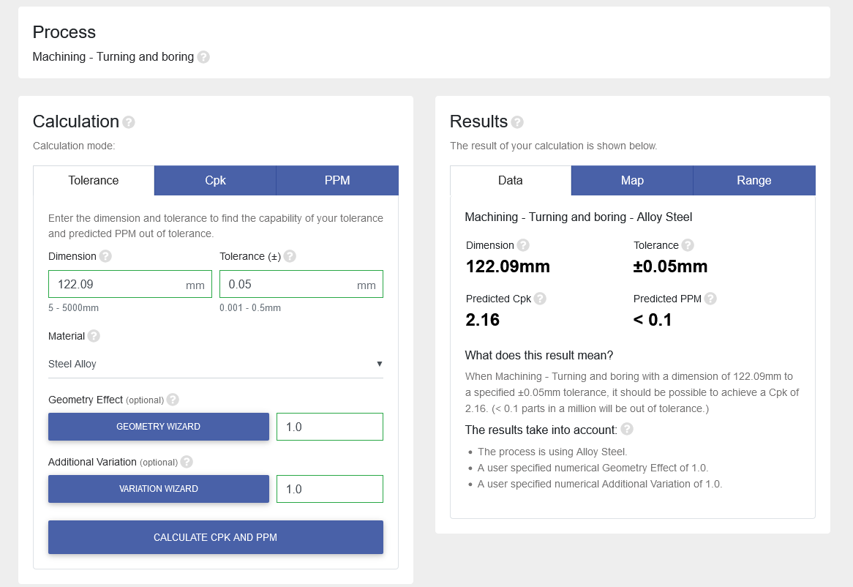

Tolcap Software - Examples
Process Capability Results
SPC Data
Cpk = 1.79

Slide 34
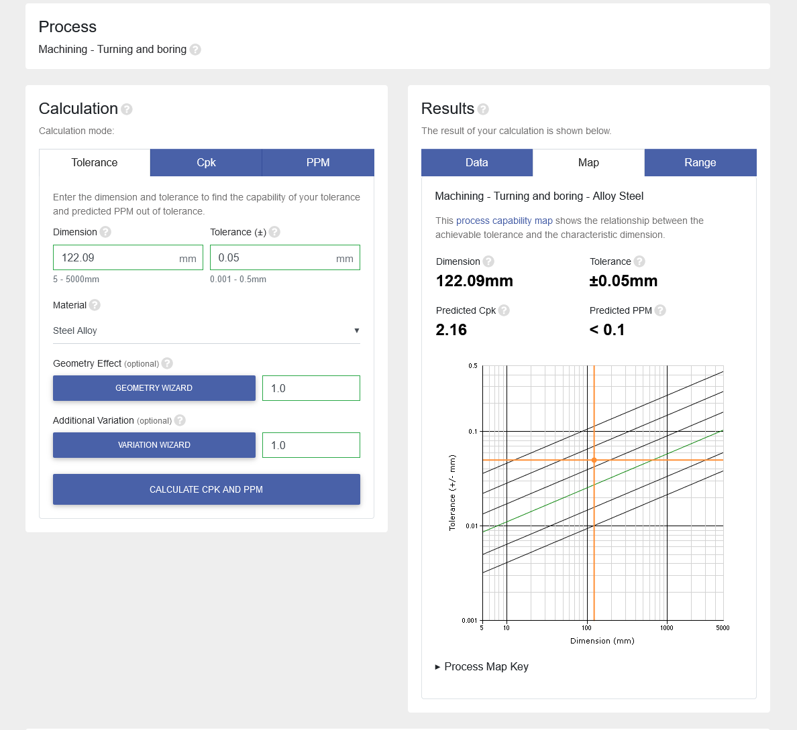
Tolcap Software - Examples
Process Capability Results
SPC Data: Cpk = 1.79

Slide 35
Tolcap Software - Examples
Component Name | Plunger Housing
Drawing Number | CH1878-1021
Material | Aluminium Bronze
Manufacturing Process | Turning
Characteristic Description | Overall length
Characteristic Dimension | 33.99 mm
Design Tolerance | ±0.05 mm
Surface Roughness | 1.6 μm Ra

Slide 36
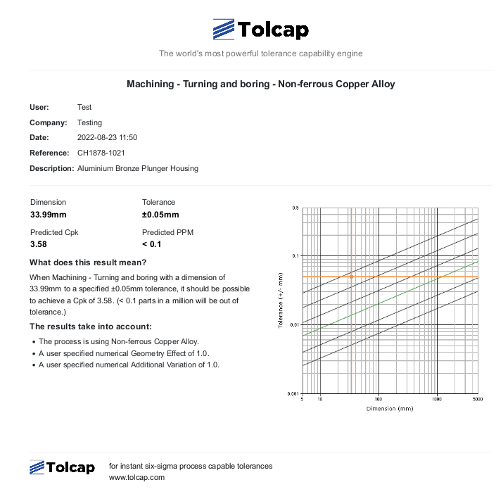
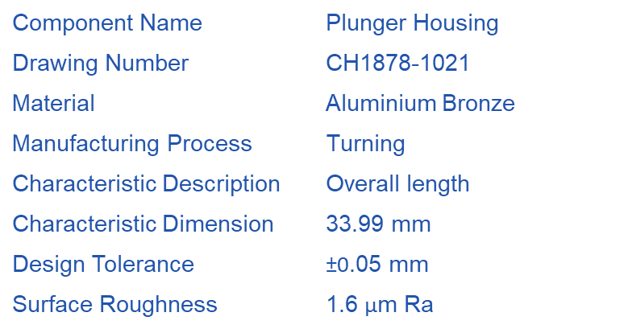
Tolcap Software - Examples
Process Capability Results
SPC Data: Cpk = 2.99

Slide 37
Tolcap Software - Examples
Component name | Cylinder housing
Drawing number | CH1878-1018
Material | Alloy steel
Manufacturing process | Turning
Characteristic description | Outside diameter
Characteristic dimension | Diameter of 50.9 mm
Design tolerance | ± 0.1 mm

Slide 38
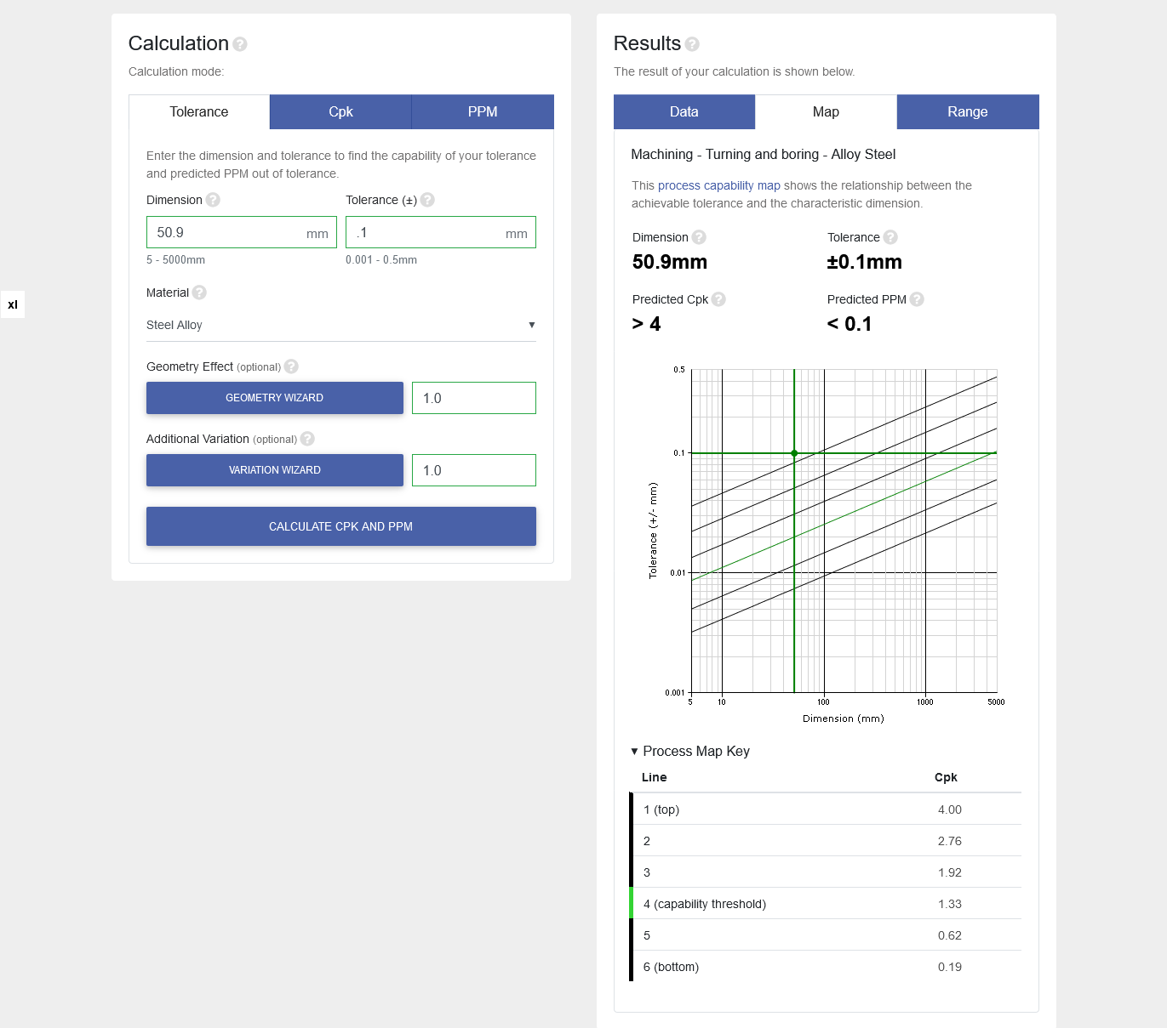
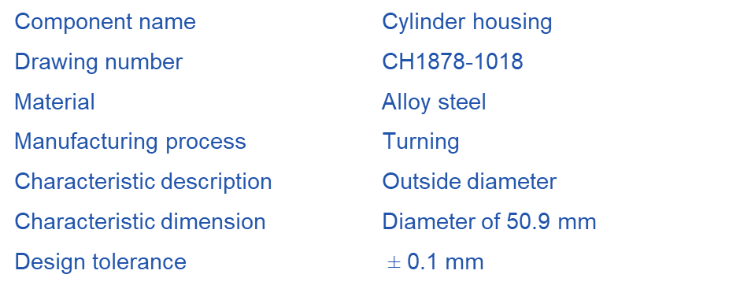
Tolcap Software - Examples
Process Capability Results
SPC Data: Cpk = 4.31

Slide 39
Tolcap Software - Examples
Component name | Bracket
Material | Mild steel
Manufacturing process | Sheet metal punching
Characteristic description | Diameter
Characteristic dimension | Diameter of 5.4mm
Design tolerance | ± 0.1mm

Slide 40
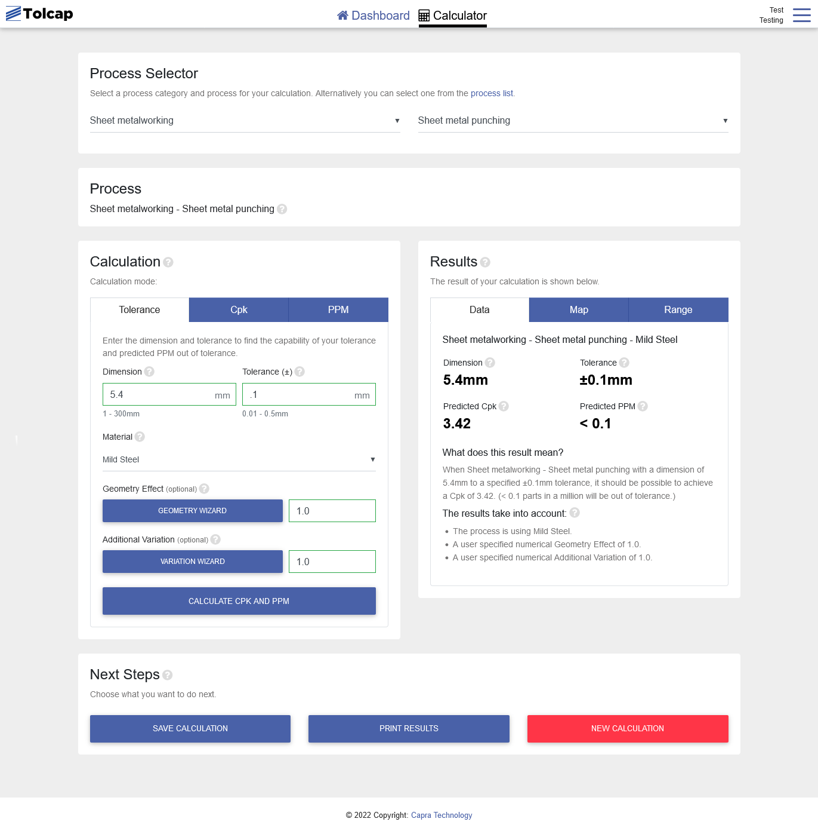
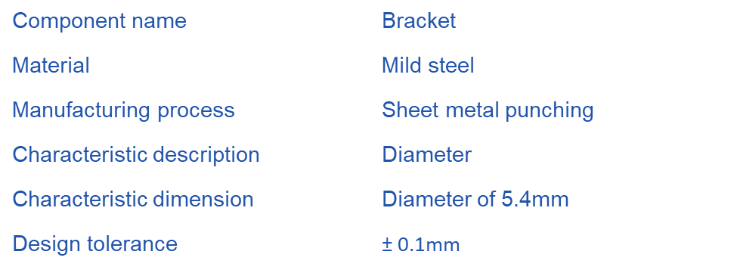
Tolcap Software - Examples
Process Capability Results
SPC Data: Cpk = 2.63

Slide 41
Tolcap Software - Examples
Component name | Capacitor clip
Material | 0.4 mm Alloy Steel
Manufacturing process | Sheet metal cutting
Characteristic description | Width
Characteristic dimension | 18 mm
Design tolerance | ± 0.2 mm
18 ± 0.2 mm

Slide 42
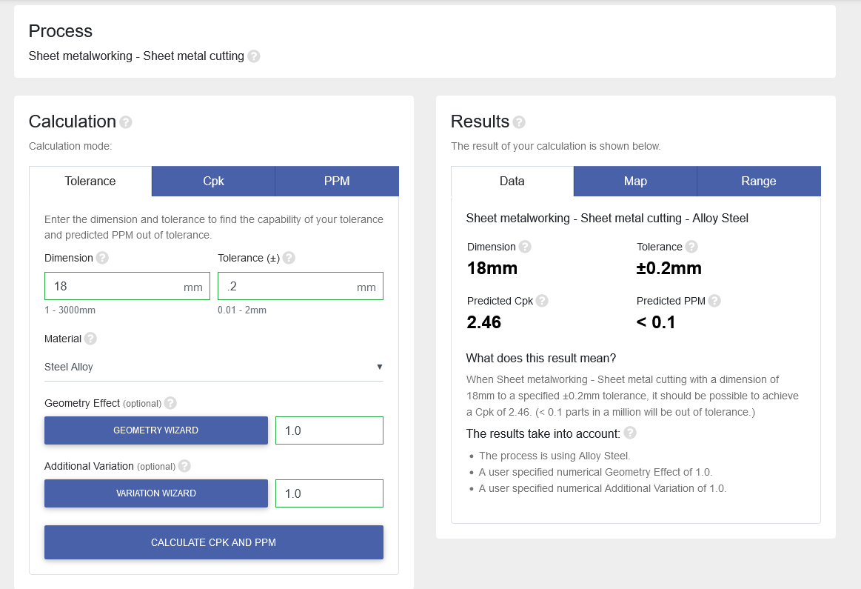
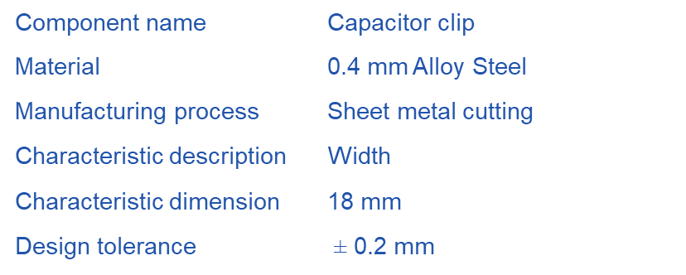
Tolcap Software - Examples
Process Capability Results
SPC Data: Cpk = 2.24
18 ± 0.2 mm

Slide 43
Tolcap Software
Using the Geometry wizard

Slide 44
Geometry Wizard
Component geometry has a significant effect on process capability.
In the analysis we consider effects including:
Multiple planes
Slenderness
Repetitive features
Number of set-ups
Parting line
The effect of such geometric features are modelled using Geometry Effect factors. These factors are combined to produced an overall numeric Geometry Effect value.

Slide 45
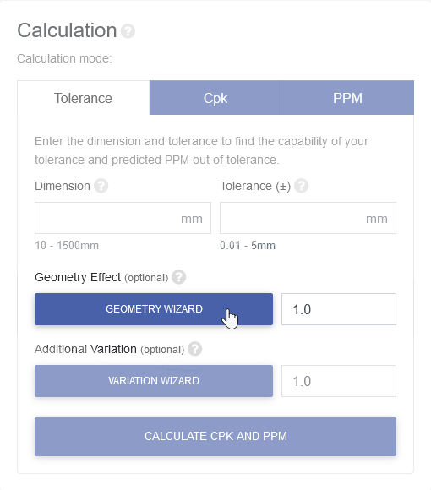
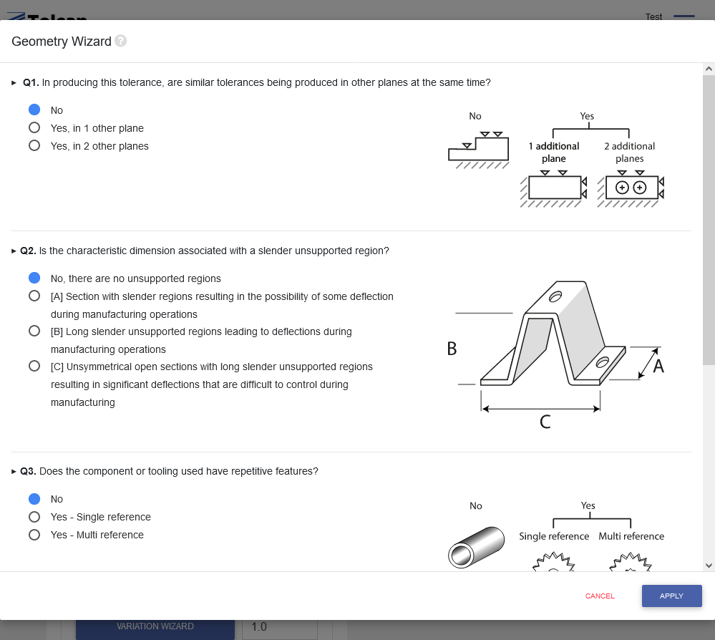
Geometry Wizard

Slide 46
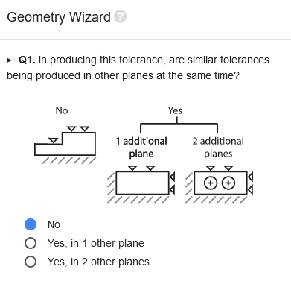
Geometry Wizard
Planes

Slide 47
Geometry Wizard
Planes
Processing critical characteristics having similar tolerance values in two or more planes within a set-up using a point/form tool or by means of a mould/die element represents an additional source of variation.
For example:
Three-planes – in milling where a pocket is being generated in a single operation with critical tolerances length, width and depth.
Two-planes - in turning where a length and diameter are both being turned simultaneously with the same level of critical tolerances

Slide 48
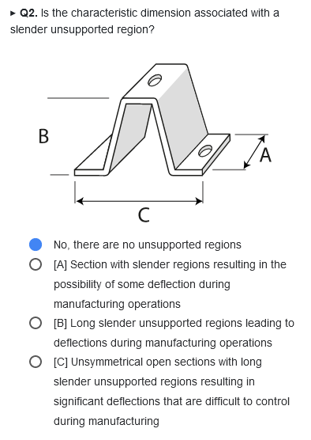
Geometry Wizard
Slenderness

Slide 49
Geometry Wizard
Slenderness
The example is shown to illustrate the concept that slender unsupported regions with large length to diameter or thickness ratios are potential sources of variation during processing.
Open sections or those that are unsymmetrical in the direction of loading stress (due to processing forces, shrinkage or residual stress warping etc) will be more liable to distortion during processing.
Good practice in manufacturing operations will be working to reduce the extent of the distortion. For example, steadies in machining and making allowances for ‘spring-back’ in the design of metal forming tools. Such processing methods have been taken into account in the determination of the factors.

Slide 50
Geometry Wizard
Slenderness Examples
Turning a bar or using a tool where the length to diameter ratio is such that deflections occur due to machining forces
During casting where thin sections can deform on cooling due to thermal stresses
In sheet metal work where the thin unsupported regions are liable to spring-back due residual stresses.
This also covers the situation when long slender tooling is being used.

Slide 51
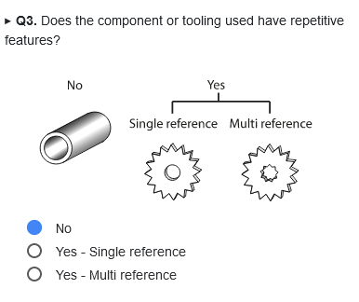
Geometry Wizard
Repetitive features

Slide 52
Geometry Wizard
Repetitive features
Repetitive features require greater process control and more complex set-up or special tooling requirements. This introduces an additional source of variability. This factor can be used to model the effects of multi-cavity moulds and multi-form tools, as well as the machining of repetitive characteristics.
Examples include: holes on a PCD; gears, racks, pinions and splines and where such repetitive features are in combination with other location features.

Slide 53
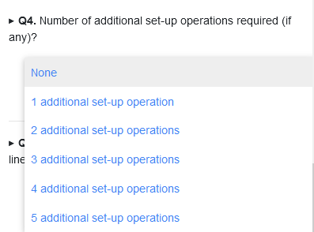
Geometry Wizard
Number of additional set-up operations

Slide 54
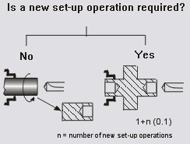
Geometry Wizard
Number of additional set-up operations
There is an increased risk of variation each time a new set-up operation and additional process step is required due to changes in the orientation or location of the part or tooling.
This is only relevant when datums are lost between set-ups, and would typically be one or two operations.

Slide 55
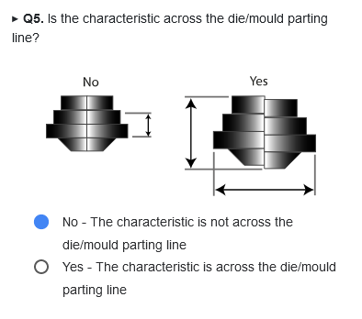
Geometry Wizard
Parting Line

Slide 56
Geometry Wizard
Parting Line
Allowances should be made for tolerances across the parting line. Allowance may also be required for mismatch of the dies/moulds in some casting and forging processes. Flash thickness allowances may also be required in closed die forging.
Note this only applies to casting, moulding and forging processes.

Slide 57
Geometry Wizard
The range of the factors are as follows:
Multiple planes [1.2 – 1.3]
Slenderness [1.15 – 1.7]
Repetitive features [1.1 – 1.3]
Number of set-ups [1.1 – 1.5]
Parting line [1.7]
If the final Geometry Effect value is 2 then in practice it would be necessary to double the tolerance to realised the same level of process capability.

Slide 58
Geometry Wizard
Examples using the Geometry Wizard

Slide 59
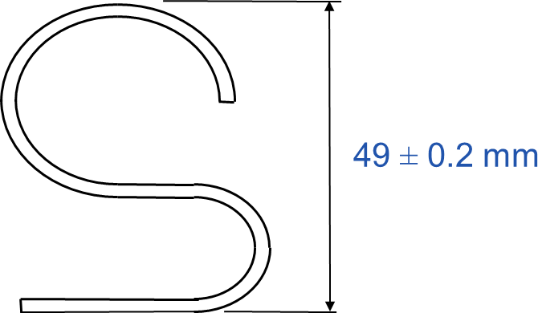
Geometry Wizard - Examples
Component name | Capacitor clip
Material | 0.4 mm Alloy Steel
Manufacturing process | Sheet metal bending
Characteristic description | Overall height
Characteristic dimension | 49 mm
Design tolerance | ± 0.2 mm

Slide 60

Geometry Wizard - Examples
Estimate the process capability index, Cpk, for the End Cover component shown:
Component name | End Cover
Drawing Number | CP 30221004
Material | Phenolic
Manufacturing process | Compression Moulding
Characteristic description | Leg Spacing
Characteristic dimension | 55 mm
Design tolerance | ± 0.2 mm
Surface Roughness | NA

Slide 61

Geometry Wizard - Examples
Estimate the process capability index, Cpk, for the End Cover component shown:
Component name | Circular Bush
Drawing Number | ERC4215
Material | Copper Alloy
Manufacturing process | Sinter and Size
Characteristic description | Bush Diameter
Characteristic dimension | 16.64 mm
Design tolerance | ± 0.025 mm
Surface Roughness | NA

Slide 62
Geometry Wizard - Examples
Component name | Capacitor clip
Material | 0.4 mm Alloy Steel
Manufacturing process | Sheet metal bending
Characteristic description | Overall height
Characteristic dimension | 49 mm
Design tolerance | ± 0.2 mm

Slide 63
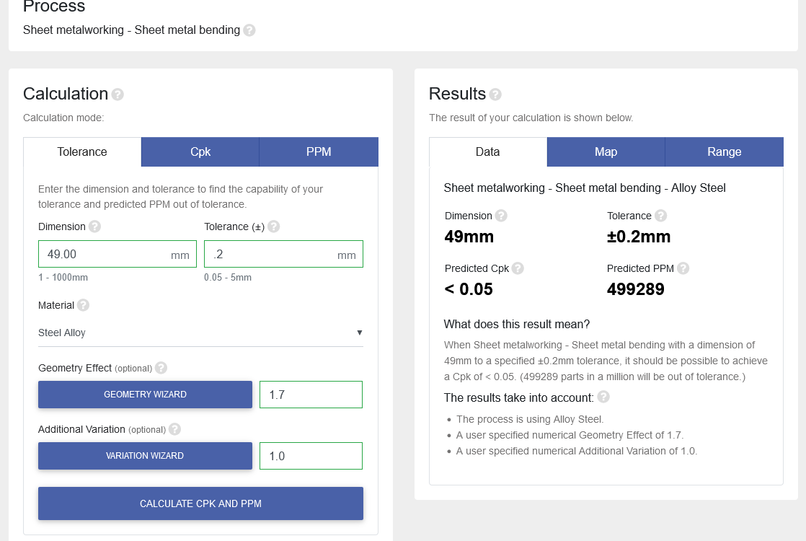
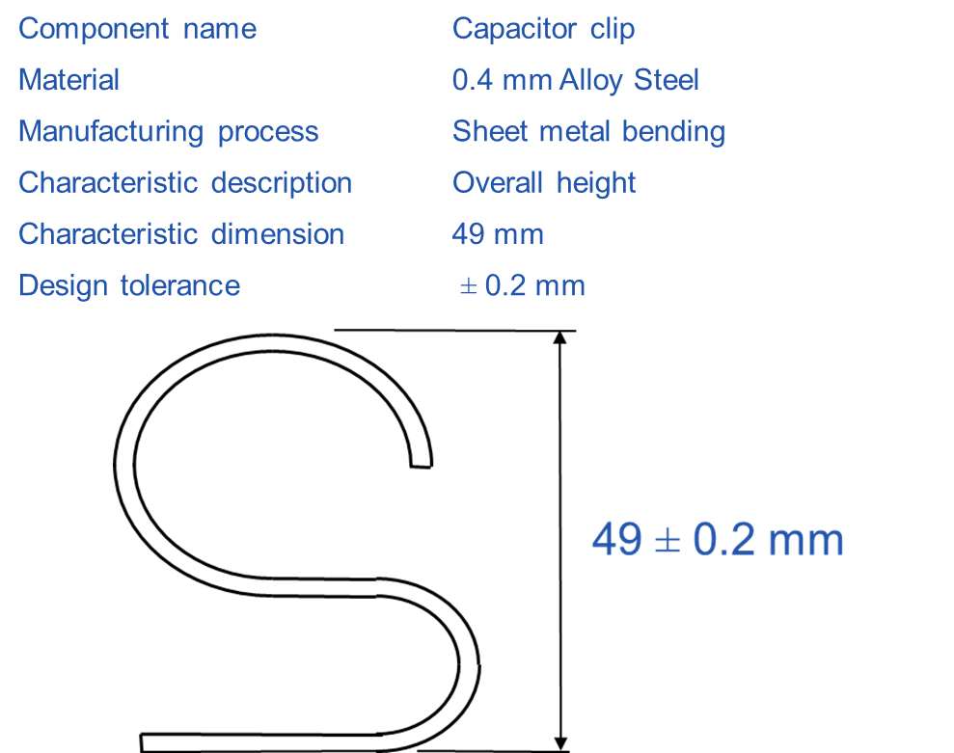
Geometry Wizard - Examples
Process Capability Results
SPC Data: Cpk = 0

Slide 64
Geometry Wizard - Examples
Estimate the process capability index, Cpk, for the End Cover component shown:
Component name | End Cover
Drawing Number | CP 30221004
Material | Phenolic
Manufacturing process | Compression Moulding
Characteristic description | Leg Spacing
Characteristic dimension | 55 mm
Design tolerance | ± 0.2 mm
Surface Roughness | NA

Slide 65
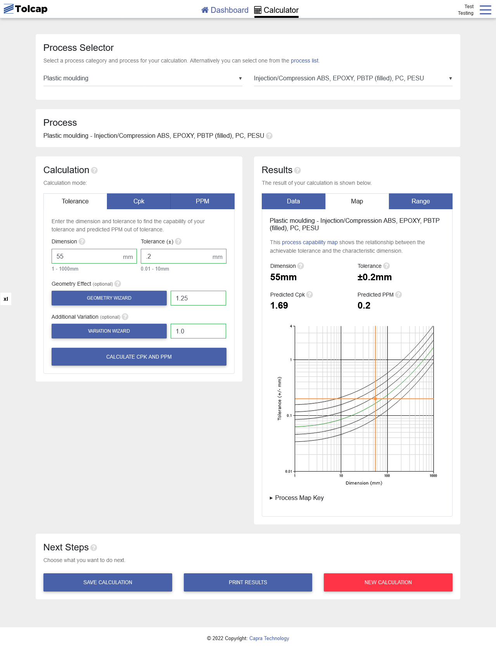
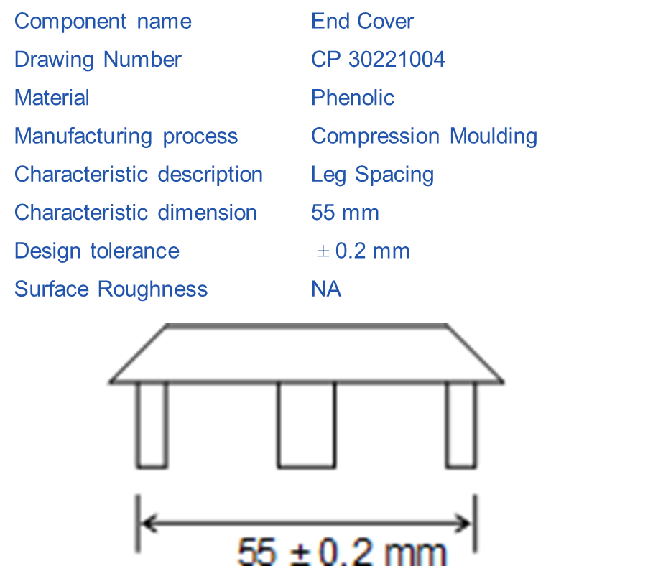
Geometry Wizard - Examples
Process Capability Results
SPC Data: Cpk = 2.04

Slide 66
Geometry Wizard - Examples
Estimate the process capability index, Cpk, for the End Cover component shown:
Component name | Circular Bush
Drawing Number | ERC4215
Material | Copper Alloy
Manufacturing process | Sinter and Size
Characteristic description | Bush Diameter
Characteristic dimension | 16.64 mm
Design tolerance | ± 0.025 mm
Surface Roughness | NA

Slide 67
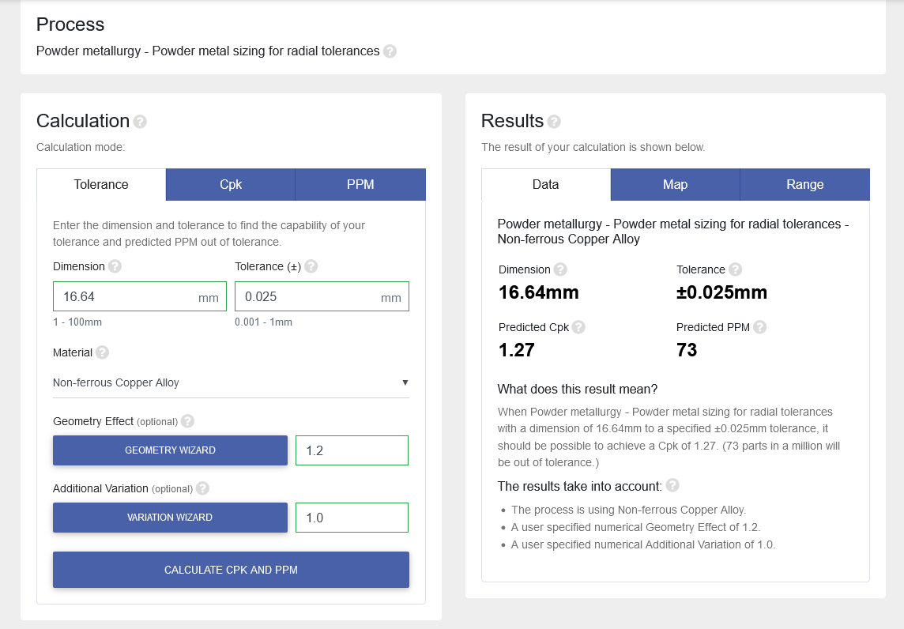
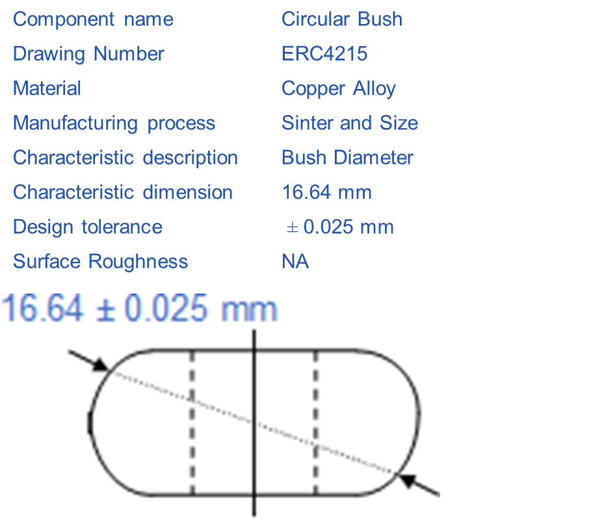
Geometry Wizard - Examples
Process Capability Results
SPC Data: Cpk = 1.2

Slide 68
Additional Variation
Using the Additional Variation wizard

Slide 69
Additional Variation
In addition to the geometry and material considerations it may be the case that there are known manufacturing constraints that can be taken into account:
Machine condition
Not good practice in manufacturing operations
Additional problems due to size and material
The above factors are combined to produce an overall Additional Variation value which can be used to reflect the limitations imposed by these constraints.
Before using the ‘Additional Variation’ analysis in the Tolcap software for analysing a component design feature it is useful for users to consider the issues covered by the following slides.

Slide 70


Additional Variation

Slide 71
Additional Variation
Is the manufacturing machinery to be used modern and in good condition?
Consideration should be given to factors including:
Machine Tool wear
Machine technology
Machine maintenance
Calibration
(Hint: Ask yourself can the capability be improved by use of a more modern machine?)
Example:
Machining – it is obvious that machining parts where machine slides/bearings are worn will lead to lower process capability.

Slide 72
Additional Variation
Does the feature geometry enable the process to be operated under conditions of good practice?
Consideration should be given to factors including:
Sequence of operations
Tooling involved in producing the component
Jigs and fixtures employed including holding the work-piece
Processing conditions (speeds and feeds in Machining)

Slide 73
Additional Variation
Examples
End Milling – use a cutter of sufficient rigidity – do not use a 3mm diameter cutter when a 25mm diameter would do the job!
Drilling – twist drills should enter, and break through, normal (at right angles) to the surface drilled – drilling at an angle can cause drill deflection and possible breakage!
Include in the process sequence the machining of a flat or better still change the design to eliminate the potential problem.
Casting – Die halves should match and die halve alignment is critical. Die closure and clamping force (parting effects) and injection velocity need careful design and control.

Slide 74
Additional Variation
Does the component size, weight, geometry or material impose any additional limitations on machine capability?
Consideration should be given to factors including:
Component size/weight
Geometry of the feature
Material to be processed

Slide 75
Additional Variation
Examples
Hole-Punching – when the forces on the punch are high the process is difficult to control – e.g. the general rule is that punch diameter must exceed the thickness of the material to be punched! Ideally the punch diameter should be greater than twice the material thickness.
Forging – Again if the forming load due to geometry or material is near to the press capacity the process will be very difficult to control.
Casting – Severe and abrupt changes in section geometry > 2:1 can cause large distortion do to markedly different thermal energy loss rates
Turning/Boring – attempting to achieved fine tolerances on a M/C not appropriate to the task.

Slide 76
Additional Variation
The range of the factors are as follows:
Machine condition [1.2]
Not good practice [1.5]
Additional factors [1.5]
Note that if the final Additional Variation value is 2 then in practice it would be necessary to double the tolerance to realised the same level of process capability.

Slide 77
Tolcap Training
Tolerance Analysis

Slide 78
Analysis process
To help the application of the Tolcap software think about the following:
Understand the functional requirements and the critically of the tolerance.
Remember datum features are important to specifying functional tolerances. They include faces, shoulders or the centre line of a hole or component. Note: functional and manufacturing datum features are not always the same!

Slide 79
Analysis process
Think about the process sequence and production machine - this will help in defining the manufacturing datum(s). For example, the manufacturing datum for a turning operation is typically the right-hand face for axial dimensions.
Consider tolerance stack effects - sometimes the tolerance on a characteristic will depend on the achievement of tolerances on other dimensions.
Decide on the dimension(s)/tolerance(s) to be entered- it may be necessary to distribute tolerances to get the most accurate prediction.

Slide 80

Tolerancing Example
Machine Bearing

Slide 81

Tolerancing Issues
It is sometimes necessary to use engineering interpretation in the application of the software to achieve the best results
How should we use the software to help allocate such tolerances?

Slide 82

Tolerancing Issues
Worst Case Analysis
Note: In a similar way if a small characteristic dimension is being manufactured at a large diameter consider carefully which dimension you use in the analysis.

Slide 83


Tolerancing Issues
If distance L is greater than diameter D, for the best prediction L is used as the characteristic dimension.
If diameter D is greater than L, for the best prediction D is used as the characteristic dimension.

Slide 84
Wash-up
Potential Benefits
Supplier development
Capable tolerance stack design
Lower manufacturing cost
Reduced quality failure cost
Shorter time to market
Reduced risk
Process selection support
Traceability
Standard tolerance allocation method

