Slide 1
Why use Tolcap?
Predicting Process Capability - Before Production Starts!

Slide 2
What is Design / What is a Design?
To Design – Verb?
To transform (useful) Function into Form
A Design (The Design) – Noun?
A Design is an Instruction to the Supply Chain
A Design is a Contract between Supplier and Customer, through the supply chain
Corollary
A Design must be a Capable Instruction
A Design must be a Feasible Contract
A Design must be Manufacturable at lowest cost

Slide 3
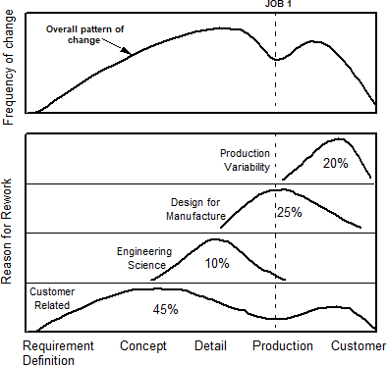
Cost of (poor) Quality
How much? Where does it come from?
Studies suggest average costs of quality of 10 – 20% of sales!
It is generally said to be unpredictably variable across products
The historic cost of rework is averaged and allocated in overheads
Even though products may generate very different amounts of rework, scrap, returns, warranty…

Slide 4
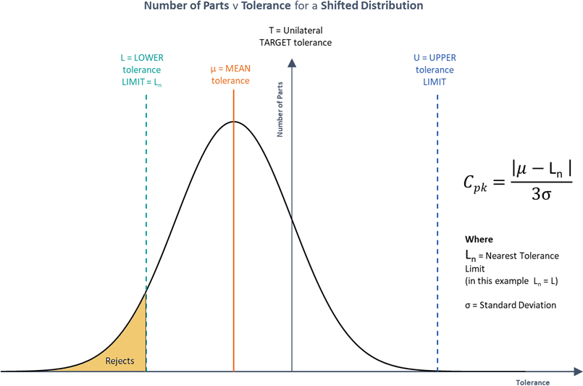
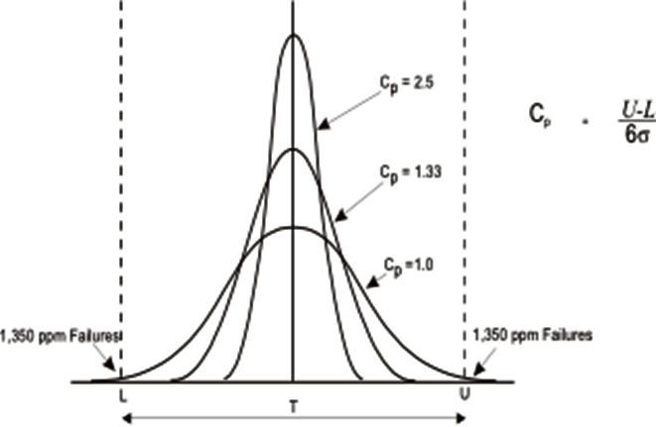
Process Capability Indices
Link tolerance and process variation
Process Capability for a Central Distribution
Process Capability for a Shifted Distribution

Slide 5
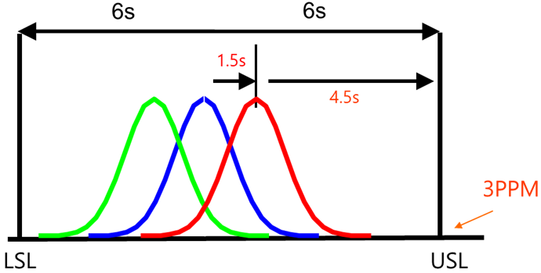
What is Design for Six Sigma?
What it says on the Label!
All the “Y”’s (CCR’s / CTQ’s) are Six Sigma capable
All the “X”’s (Design Characteristics) are Six Sigma capable
The Design is robust to Six Sigma noise levels
So we need to predict process capability to show we have Six Sigma

Slide 6
Predicting Process Capability
We are designing for process capability / ‘Designing for Six Sigma’
So how many Sigma will we get into production?
‘Doesn’t this delay release?’ ‘Doesn’t this increase costs?’
We can’t afford the delay or the capable process?
OK, but who pays the cost of quality?
Which Dimensions are ‘Special Characteristics’?
Those where we cannot assume Six Sigma capability.
Do you think your supplier will deliver a capable part?
We need to have a sensible discussion.

Slide 7
The Key Question to Suppliers
Predicting Process Capability enables you to ask the right question when reviewing your design with the supplier.
The wrong question is: ‘Can you make this part (capably)?’
The answer is likely to be … ‘Yes!’
If the design is good, then all is well.
If the design is a problem, it will be a problem to other suppliers … they won’t be able to do any better.
If the design is really bad, you might just be told ‘NO’ ... but don’t count on it!
A better question is: ‘Analysis shows that the predicted process capability for this dimension is (0.95), and we need 1.5 for a Six Sigma design
… so what evidence do you have, or what tests can you do, to demonstrate the process capability you will really achieve?’
Maybe the Supplier has developed a special process to achieve the result.

Slide 8
Predicting Process Capability
Tolcap gives you a method of predicting process capability at the early stages of the design.
If we can predict process capability…
We can forsee potential costly design problems...
Discuss problems constructively with the supplier...
...and change the design if necessary to prevent costly problems

Slide 9
For more information visit
www.tolcap.com

