Slide 1
Tolerance Stacks
Why you need Tolcap for a capable stack tolerance

Slide 2
Tolcap for Tolerance Stacks
Statistical tolerancing is almost always misapplied!
Tolerance stacks are not easy, and this presentation sets out to explain:
The assumptions of statistical tolerancing
Why Tolcap is vital for valid statistical tolerancing
A straightforward method of calculating a sound statistical stack tolerance using Tolcap

Slide 3
The Tolerance Stack Problem
d₁ ± t₁
d₂ ± t₂
d₃ ± t₃
d₄ ± t₄
We set tolerances for components, but it is often necessary to ensure the parts fit properly when they are assembled together.
The diagram above represents an assembly.
Three ‘blocks’ dimensioned d₁ ± t₁, d₂ ± t₂ and d₃ ± t₃ are fitted side by side into a ‘cradle’ dimensioned d₄ ± t₄.
Will they fit?
Clearly we need d₄ > d₁ + d₂ + d₃ to allow for the blocks being larger than nominal size, but if the difference is too large, the assembly may be too ‘slack’ when the blocks are smaller than nominal.
So what should we specify for d₄?

Slide 4
The Tolerance Stack Problem
d₁ ± t₁
d₂ ± t₂
d₃ ± t₃
d₄ ± t₄
Worse case:
The assembly will always fit if the parts are in tolerance and:
d₄ – t₄ > d₁ + t₁ + d₂ + t₂ + d₃ + t₃
or d₄ = d₁ + d₂ + d₃ + t₁ + t₂ + t₃ + t₄ (note we add t₄)
More often than not when the dimensions are at the opposite end of the tolerance band, the assembly would be unacceptably slack. In this case it is common practice to use:
Statistical Tolerancing: d₄ = d₁ + d₂ + d₃ + √{t₁² + t₂² + t₃² + t₄²}
This gives a smaller answer for d₄, so less ‘slack’ - but is it justified?

Slide 5
Statistical Tolerance Justification
We know that ‘root-sum-squaring’ numbers gives a smaller answer than just adding them up. But does it mean anything?
The basis of statistical tolerancing is a mathematical theorem:
If a variable (let’s call it ‘stack’) is constructed by adding or subtracting a number of component variables that are all independent and normally distributed, with mean Xbar_{i} and standard deviation σ_{i} then ‘stack’ will also be normally distributed with:
Mean = Xbar_{stack} = Σ Xbar_{i}
and
σ_{stack} = √Σ σ_{i}²
‘Σ’ means add up all the Xbar’s or σ’s
The Xbar_{i} ’s have to be added algebraically, that is added or subtracted as appropriate, but the σ_{i}² are all positive and all add.
√(x²+y²)
x
y

Slide 6
The Tolerance Stack Problem
d₁ ± t₁
d₂ ± t₂
d₃ ± t₃
d₄ ± t₄
If we could travel forward in time, we could measure the dimensions of the components in the stack, assure ourselves they are indeed independent, check that they are normally distributed and measure Xbar_{i} and σ_{i}. Then we could properly calculate the stack tolerance.
If our tolerances happen to be the same multiple of the sigma’s, and if the Xbar_{i} all come out at the nominal dimension, then ‘root-sum-squaring’ the tolerances will work.
But how do we know?
If we don’t know, there is no justification for ‘root-sum-squaring’!
But we have Tolcap! ...

Slide 7
The Tolerance Stack Problem
d₁ ± t₁
d₂ ± t₂
d₃ ± t₃
d₄ ± t₄
Let’s continue to use the same example to explore the traditional approach to statistical tolerancing and then to look at a method for calculating stack tolerances using Tolcap.
We will compare and explore how stack tolerances are calculated as a function of the component tolerances:
t_{stack} = f{t_{i}}
e.g. t_{stack} = √Σ t_{i}² = √(t₁² + t₂² + t₃² + t₄²)
The algorithms or equations will be given and explained for the general case, but purely to compare approaches we will take the specific (if implausible) case where all the component tolerances happen to come out equal:
t₁ = t₂ = t₃ = t₄ = t let’s call that t*_{stack}

Slide 8
Some Maths
The following slides will use some maths, so let’s review some mathematical manipulation here.
As explained above, Σd_{i} means add up all the values (and don’t forget they may be plus or minus).
So in our example, to calculate the nominal ‘gap’: Σ d_{i} = – d₁ – d₂ – d₃ + d₄
Recall that √Σσ_{i}² means square all the sigmas, add them all up (no minuses unfortunately!) and take the square root of the sum.
Note that, where c is a constant
√Σ(cσ_{i})² = √Σc²σ_{i}² = c x √Σ σ_{i}² i.e. we can take any constant outside the brackets.
That enables us to say for example that
If t_{i} = 6σ_{i,} then √Σσ_{i}² = (√Σ t_{i}²)/6 or even √Σ(4.5σ_{i})² = (√Σt_{i}²) x 4.5/6
Finally, for the purpose of the comparative example, note that for four equal tolerances:
t₁ = t₂ = t₃ = t₄ = t*
Σ t_{i} = 4t* but √Σ t_{i}² = 2t*

Slide 9
Traditional Statistical Tolerancing
When statistical tolerancing was conceived, a tolerance of just 3σ was considered entirely adequate!
Assuming component tolerances were set at 3σ, a three sigma stack tolerance was calculated as √Σt_{i}² .
This procedure was found to give optimistic results, and in 1962 Arthur Bender Jr published a paper which proposed adding a 50% margin to the stack tolerance, thus
t_{stack} = 1.5√Σt_{i}²
‘Benderizing’ is still a mainline traditional approach.
Tolcap predicts C_{pk} rather than σ, but we can readily make use of Tolcap to analyse the traditional method and then look at how it can be developed and improved.

Slide 10
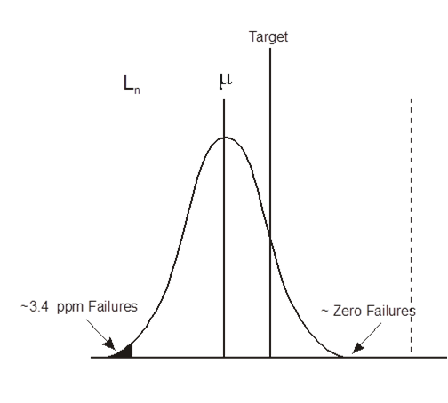
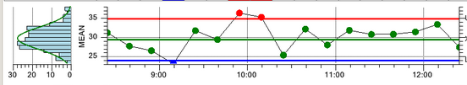
A Six Sigma Stack Tolerance
Design for Six Sigma says to set the tolerance to six sigma to allow 1.5σ for the ‘process shift’ i.e. to allow for the other assumption of the maths of normal distributions that the mean of the parts may not match the nominal dimension.
Does this mean that the process shift for every manufacturing process really is 1.5σ ? No! - but if necessary that shift could be detected in production (using a four-sample Xbar _R control chart). A control chart cannot be too commonly required, so this implies that 1.5σ is generally sufficient.

Slide 11
A Six Sigma Stack Tolerance
The empirical data in Tolcap reflects the reality of the various manufacturing processes and confirms that 1.5σ is sufficient - but not necessary. The process shift in Tolcap may be as much as 1.5σ, but it will be smaller if appropriate to the process.
Extracting the process shift from Tolcap is no simple matter - it varies across the maps, and the effect of the wizards depends on which issues are being compensated.
So let’s use Tolcap taking the Six Sigma approach that 1.5σ gives a reasonable conservatively large process shift.
A sensitivity analysis will be addressed in a later slide.

Slide 12
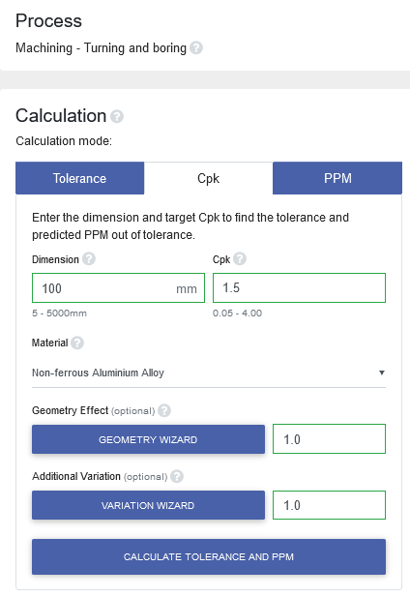
Traditional Statistical Tolerancing
To analyse tolerancing algorithms we will get our tolerances from Tolcap. We will use Tolcap to find the tolerance we need to achieve a target process capability. We want sigma values for these tolerances.
Let’s start with the ‘Six Sigma’ approach and tolerances:
Open Tolcap, select a process, and select the C_{pk} tab rather (than Tolerance).
Enter the nominal dimension.
Set Target C_{pk} to 1.5
Apply the wizards and find what tolerance Tolcap gives.
Repeat for each dimension in the stack.

Slide 13
Traditional Statistical Tolerancing
Now we can analyse the traditional approach!
Assume Tolcap has given us ‘Six Sigma’ tolerances: t_{i} = 6σ_{i}
So if we did want three sigma tolerances for the traditional approach, we could halve the Six Sigma tolerances and get t_{i}/2
Our (three sigma!) stack tolerance is then:
t_{stack}=√Σ(t_{i}/2) ²=(√Σt_{i}²)/2=0.5√Σt_{i}²
The ‘Benderized’ tolerance would be 50% larger, i.e. 0.75√Σt_{i}² .
In the specific comparison case where all the tolerances are equal, remembering that √Σt_{i}² = 2t
t*_{stack}=√Σ(t_{i}/2)²= (√Σt_{i}²)/2=2t/2=t
and the Benderized tolerance would be 1.5t.
But do remember that t is a Six Sigma component tolerance ... and don’t we want a Six Sigma stack tolerance to go with that?

Slide 14
A Six Sigma Stack Tolerance
How could we work out a six sigma stack tolerance ?
Maybe we just root-sum square the component tolerances?
That works for component tolerances:
So t_{stack}=√Σ(t_{i})² and for equal tolerances t*_{stack}=√Σt_{i}² = 2t
Or maybe we still need to ‘Benderize’ the tolerance?
Do we need the full 50% extra? t*_{stack}=1.5 x √Σt_{i}²=3t ...
Or is the traditional correction for three sigma tolerances enough?
That would be an extra 25%, so t*_{stack}=2.5t
Let’s look at the process shift allowance more closely.

Slide 15
A Six Sigma Stack Tolerance
The process shift recognises that the mean dimension of the parts is not necessarily equal to the nominal dimension on the drawing.
Thinking real process shifts, for some processes such as turning, the shift will depend on how well the setter has set up the batch.
For processes such as moulding, the process shift will to a large extent drift over time as the tool wears.
The process shift thus includes at least an element which is not variable from part to part but fixed from batch to batch, or drifts very slowly over time.
So while it makes sense to root sum square the ‘random’ part to part element of the tolerances (provided they are independent and normal), it may be prudent to combine the process shifts worst case – and simply add them up rather than root sum square them.

Slide 16
A Six Sigma Stack Tolerance
On this basis:
Our six sigma tolerance t_{i} = 6σ_{i}
Process shift is 1.5σ_{i} = t_{i}/4
Part-to-part variation is 4.5σ_{i} =3t_{i}/4
Then t_{stack}=Σ(t_{i}/4) + √Σ(3t_{i}/4)²
Simplifying the equation to make computation easier
t_{stack}=Σ(t_{i}) x ¼ + √Σ(t_{i})² x ¾
In the specific comparison case where all the tolerances are equal
t*_{stack}=4t/4 + 2t x 3/4 = t + t x 3/2=2.5t
It is tempting to say that this lines up with one of our ‘Benderised’ projections, but remember this is a special artificial example that happens to use four components.

Slide 17
A Six Sigma Stack Tolerance
But here at last is a method!
t_{stack}=Σ(t_{i}) x ¼ + √Σ(t_{i})² x ¾
Find 6σ tolerances from Tolcap, add one quarter the sum of the tolerances to three quarters the root-sum-square of the tolerances.

Slide 18
Sensitivity Analysis
The analysis above assumed a ‘Design for Six Sigma’ 1.5σ process shift in the tolerances obtained from Tolcap.
If we knew the process shifts were smaller we would modify our calculation.
For example, suppose the data in Tolcap reflected only 0.5σ process shifts for all the components of the stack. Then a C_{pk} = 1.5 tolerance will comprise 4.5σ for the short term variation plus only 0.5σ for the process shift - a five sigma tolerance where we expected a six sigma tolerance! What is the effect of this?
Process shift = 0.5σ_{i} = t_{i}/10, Part to part 4.5σ_{i} =9t_{i}/10
Now t_{stack}= Σ(t_{i}/10) + √Σ(9t_{i}/10)² = 0.1Σ(t_{i}) + 0.9√Σ(t_{i})²
If t_{stack}=0.1Σ(t_{i})+0.9√Σ(t_{i})²
then in the specific comparison case where all the tolerances are equal
t*_{stack}=0.1 x 4t + 0.9 x 2t=0.4t + 1.8t=2.2t

Slide 19
Sensitivity Analysis
Of course we didn’t know we had a five sigma tolerance, but we can have some confidence that our computation assuming t_{i}=6σ_{i} is conservative.
The margin in t*_{stack} would be 12%.
If there were processes such that all the component process shifts were zero, then each t_{i}=4.5σ_{i} , and we would want to simply root-sum-square the tolerances.
In this case we would find t*_{stack}=2t
and the margin in t*_{stack} would be 20%.

Slide 20
A 5.5 Sigma Stack Tolerance!
The analysis used can readily be applied to Tolcap’s default C_{pk}=1.33 tolerances. For the same process and dimension as in the ‘Six Sigma’ case, we still assume the process shifts are 1.5σ, and for C_{pk}=1.33, our tolerance needs another 4σ for part to part variation - this is now ‘Design for 5.5σ’ !
t_{i}=5.5σ_{i}
1.5σ_{i}=3/11t_{i}
4σ_{i} =8/11t_{i}
t_{stack} = Σ (t_{i}) x 3/11 + √Σ(t_{i})² x 8/11
So we have a simple algorithm for tolerance stacks with a minimum C_{pk}=1.5 or C_{pk}=1.33 to match our component C_{pk} .

Slide 21
Using Tolcap
We hope this presentation has explained:
The assumptions of statistical tolerancing
Why Tolcap is vital for valid statistical tolerancing
A straightforward method of calculating a sound statistical stack tolerance using Tolcap:
For ‘six sigma’ tolerances, use Tolcap to set component tolerances at C_{pk} = 1.5, and then:
t_{stack} = Σ (t_{i}) x ¼ + √Σ(t_{i})² x ¾
For Tolcap ‘default’ C_{pk} = 1.33 tolerances, use Tolcap to set component tolerances at C_{pk} = 1.33, and then:
t_{stack} = Σ (t_{i}) x 3/11 + √Σ(t_{i})² x 8/11

Slide 22
For more information visit
www.tolcap.com

